Slide 1
Lincolnshire Crime & Policing Survey 2019-20 Final Debrief Presentation
Prepared for: Marc Jones, Police & Crime Commissioner for Lincolnshire 24 February 2020 v1.0
© Habit5 2020

Slide 2
Contents
Background & methodology
Sample profile
Survey findings
Key metrics dashboard
Summary findings & recommendations
Next steps

Slide 3
Background & methodology

Slide 4
Objectives What we needed the research to achieve
The objectives for the research were to:
Actively engage and consult with the people of Lincolnshire regarding crime and policing, in a statistically robust and truly representative manner
Enhance and deepen understanding of …
The public’s needs for information regarding crime prevention
Preferred approach to expenditure on, and budgeting for, policing in Lincolnshire
Knowledge of the role and remit of the PCC
Provide the data and insights to make evidence-based strategic decisions
Evaluate the public’s perception of police effectiveness in combating different types of crime
Investigate opinion regarding the academic qualifications that new police officers should hold
Compare year-on-year trends versus the surveys in 2017 and 2018-19.

Slide 5
Who we needed to understand Permanent residents of Lincolnshire
The ONS mid-year 2017 population estimate for Lincolnshire of 599,746 Adults aged 18+ was used to calculate the target sample required, in order to achieve a Confidence Interval of ±6 or better for each of the demographic segments on the right at the 95% Confidence Level.
The Confidence Interval for the sample as whole, at the County Level is ± 1.70 in 2019-20 (± 1.66 in 2018-19).
Actual completed surveys achieved are shown beside the % of the target achieved. All target sample levels were met and exceeded for each segment, with the exception of 16-34 year-olds and residents of Boston Borough.
 | % of Target Achieved | Actual volume of Survey Completes achieved
Age Band
16-34 | 87% | 399
35-49 | 149% | 680
50-64 | 247% | 1129
65+ | 220% | 1078
Gender
Male | 170% | 1531
Female | 172% | 1652
Local Authority
Boston | 98% | 262
East Lindsey | 264% | 703
Lincoln | 147% | 392
North Kesteven | 223% | 593
South Holland | 154% | 410
South Kesteven | 170% | 451
West Lindsey | 179% | 475
Socio Economic Group
ABC1 | 225% | 2421
C2DES | 110% | 866
Total | 177% | 3302
Confidence Level & Confidence Interval # The total sample size was based on a 95% Confidence Level and a minimum Confidence Interval by segment (e.g. West Lindsey) of ± 6.
This is to ensure the statistical significance of the results for each segment. It means that had we surveyed everyone in our segment population the answer to a given question would fall within 6 percentage points of our research result (in either direction) on 95 occasions out of 100.

Slide 6
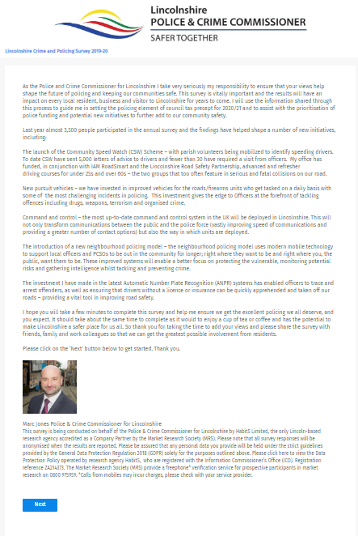
How we conducted the research Online Quantitative Survey
An online quantitative survey was used, titled the: ‘Lincolnshire Crime and Policing Survey 2019-20’. Sponsorship of the survey was explicitly ascribed in the introduction to Marc Jones, as Police & Crime Commissioner for Lincolnshire.
The survey was device responsive across: desktop computers, tablets and smartphones.
3,302 fully completed surveys were achieved, just 147 fewer than in 2018-19 in eight fewer days’ in field.
All participants were qualified as being:-
16 years of age or older
Permanently resident in Lincolnshire
Fieldwork was conducted between 16th December 2019 and 12th January 2020.
All fieldwork was conducted in accordance with the MRS Code of Conduct.

Slide 7
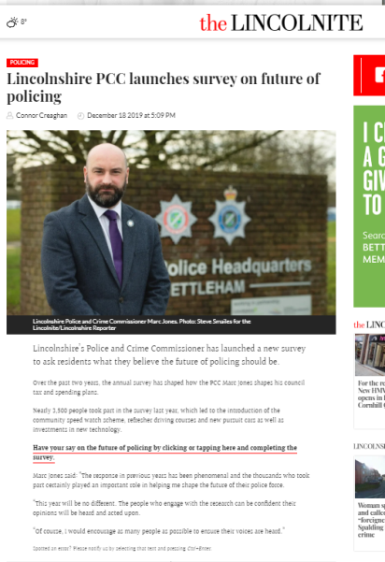
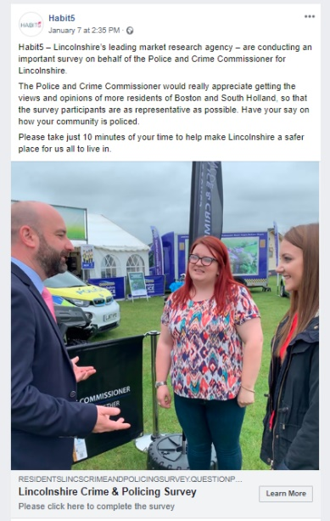
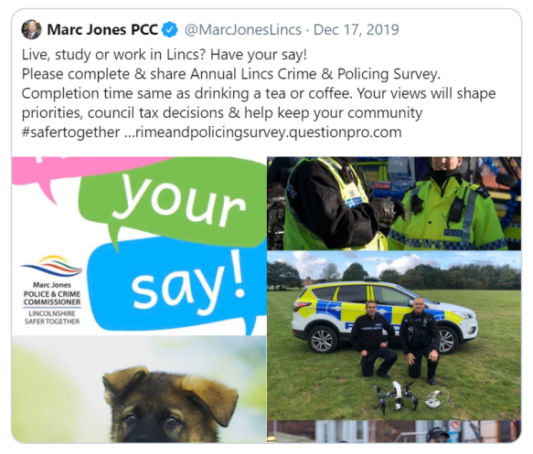
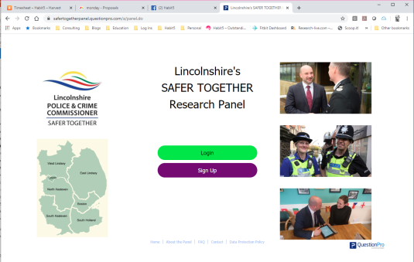
Recruiting participants Several different media channels were deployed
In order to maximise and diversify public engagement with the survey, several different media channels were used to promote it.
Paid for sources were only introduced once the no-cost sources had been fully leveraged, in order to minimise overall participant recruitment costs.
These two sources accounted for 651 participants within the total sample of 3,302 or 19.7%.
SAFER TOGETHER | Twitter & Lincs Alert | PR from Press Release | Facebook Promotion | Consumer Panel
For the first time members of the new Lincolnshire’s SAFER TOGETHER Research Panel were invited to complete the Annual Survey and 56% of them did so. | As well as a pinned tweet on Lincs PCC Twitter feed, survey invitations were sent to Lincs Alert members, by both email and SMS. Several affinity organisations promoted the survey to their members and subscribers. | Press releases were issued referencing the survey. The story was picked up and featured on several news websites including the Lincolnite. | A promotional (PPC) post on Facebook featuring a link to the survey was deployed & targeted to specific demographic segments: females, under 50s and Boston or South Holland residents, who proved harder to reach in other channels. | Dynata access panel participants were recruited again to top-up sample amongst harder to reach target segments, chiefly females and the under 50s.

Slide 8
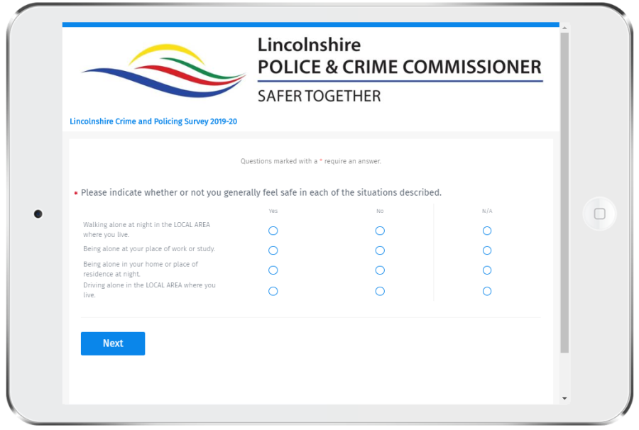
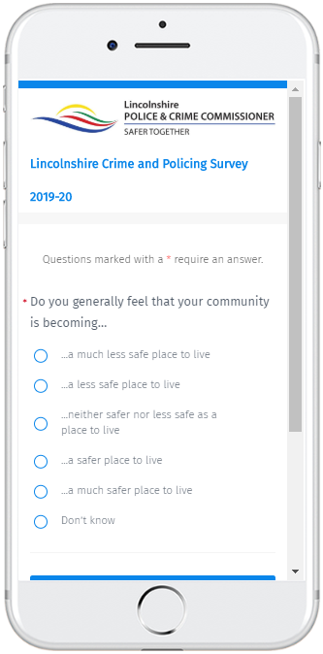
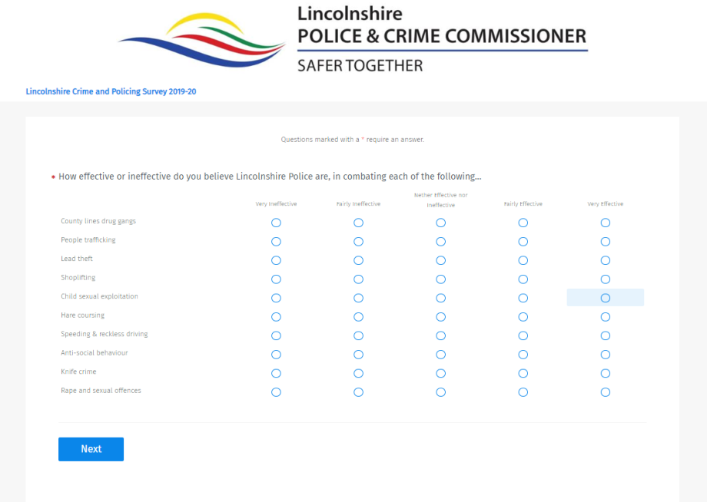
Survey structure Balancing comprehensiveness & completion rate
Question themes
Age (Under 16s screened out)
Residence (Non-Lincolnshire screened out)
Duration of residence
Safeness in the County & Local Community
Worry of crime
Incidence of crime experienced
Perspective on local area
Police effectiveness in combating crime
Police funding perceptions
Council Tax Band / Prepared to Pay
Police officer qualifications
Crime prevention measures
Initiative awareness
Awareness of PCC role
Relationship Status
Employment Status
Social Grade
Household composition
Gender
Ethnicity
Other Matters
Willingness to join Panel

Slide 9
Sample profile
NB All survey results
shown in this presentation relate to the 2019-20 survey unless annotated otherwise.

Slide 10
Sample variation from the resident population of Lincolnshire
As detailed within the Background section, we set minimum target sample volumes by:
Gender
Age Band
Local Authority
Socio Economic Group (e.g. ABC1, C2DE)
We did not cap sample at these minimum volumes, as we wished to engage and enfranchise as many people as possible. In 2019/20 we were again utilising channels that could not simply be ‘switched off’ (e.g. Lincs Alert, PR, affinity groups, etc). We therefore have higher overweight positions within demographic segments who exhibit a greater propensity to engage in completing the survey.
Within analysis we have the option to:
A] Use the largest sample possible, if isolating results amongst a particular demographic e.g. 35-49 year-olds
B] Use the total sample available
C] Use a weighted sample to reflect the distribution of the actual population of Lincolnshire on a given demographic, rather than their incidence in the total sample population, e.g. examining results re-calibrating age band to adjust for our overweight amongst 50+ year-olds

Slide 11
For the first time, more female residents (50%) completed the survey than males (47%) which reflects the slight imbalance in the population of the county.
Gender by Year of Survey
NB There is no ‘Prefer not to say’ category within the ONS Population data, this impacts the survey split a little.

Slide 12
50-64 year-olds were the mode age band for the 2019-20 Survey, in 2018-19 this was the 65+ age group.
What is your age? (Please select one option only)
Age Band
A +4% point YOY increase in the share of the sample amongst 35-49 year-olds was also achieved.
Continued effort is required to drive the profile of the sample base to be younger.

Slide 13
The ethnic distribution of the survey sample is virtually unchanged from last year, again 93% of participants self-categorise as White British, which mirrors the population.
What is your ethnic group?
Ethnicity 2019-20
Base: White British (n=3,057), Mixed/multiple ethnic groups (e.g. White and Black African) (n=13), White European (n=75), Asian/Asian British (n=13), Black/African/Caribbean/Black British (n=10), Other ethnic group (E.g. Arab) (n=16), Prefer not to say (n=102), Sample Size = 3,286

Slide 14
As last year, very nearly a fifth (19%) of participants are the sole adult in their household, with around two thirds (64%) living in households comprising two adults.
How many adults aged 18 or over, including yourself, live in your household?
Number of Adults in Household

Slide 15
The number of participants with under 18s in their household fell very slightly year-on-year, with just over a fifth (21%) having at least one young person or child within their household.
How many children and young people, aged 17 and under, live in your household?
Number of under 18s in household

Slide 16
The socio-demographic profile of the participant sample is very consistent with that in the previous two years.
Please select the description below which best matches the occupation of the chief income
earner in your household, or their occupation prior to retirement. Socio Economic Group (SEG)

Slide 17
As in 2018, 74% of survey participants in 2019 again fall into the ABC1 Socio Economic Groups, compared with 59% of the population of Lincolnshire.
Please select the description below which best matches the occupation of the chief income earner in your household, or their occupation prior to retirement:
Socio Economic Groups (SEG) by year of survey
New ways to engage more participants amongst the C2DE segments need to be identified for the next wave of the survey.

Slide 18
Nearly two thirds (63%) of participants’ categorise themselves as married, with just 9% single, never married.
Which of the following best describes your current relationship ✱ status?
Relationship Status 2019-20

Slide 19
Nearly half (47%) of the participants indicated that they live in a village or hamlet, just over a third (36%) live in a town and 12% live in a city.
Which of the following best describes where you live...
Area of residence type 2019-20
NB This question was asked for the first time in 2019-20.
Base: A village or hamlet (n=1,555), A town (n=1,198), A city (n=399), An isolated dwelling (n=133), Other (n=17), Sample Size = 3,302

Slide 20
The pattern of ‘Length of Residence’ in the local area is nearly identical to the sample in 2018-19, with again 69% of the sample resident in the same local area for at least 10 years.
How long have you lived in the LOCAL AREA? (By LOCAL AREA, we mean within about a15 minute walk from your current address) Length of Residence
This extended Length of Residence provides participants with an experiential basis to evaluate long term trends.

Slide 21
Just over a fifth (21%) of the sample was drawn from residents of East Lindsey. South Kesteven was again the most under-represented Local Authority (-4% points) relative to the distribution of the actual population of Lincolnshire.
Which local authority are you permanently resident in? (Please select one option only)
Local Authority 2019-20
North Kesteven was the most over-represented authority with a +3% share relative to the population of Lincolnshire.
Year-on-Year (YOY) proportional share of the total sample rose by +2% points for South Holland.

Slide 22
The survey continues to draw a lower proportion of participants from Band A (20%) relative to their % share of the ONS Property Count for Lincolnshire (39%) with Band D (23%) over represented.
Please indicate from the options below which Council Tax Band your place of residence falls into. Sample distribution by Council Tax Band YOY and versus Property Count.
For the purpose of comparison we have excluded participants answering: ‘Exempt’ ‘Not required to pay’ and ‘Don’t know’.
NB Warning the sample for Band H is very small. n = 14 in 2019-20. It only accounts for 0.10% of properties.

Slide 23
Survey findings

Slide 24
Over three-quarters of participants (76%) believe that the funding for Lincolnshire Police should be ‘Increased further – in order to improve policing across the county’.
Do you believe that the funding for Lincolnshire Police should be...
Future Police Funding 2019-20
95% of participants in 2019-20 support some level of increase versus 83% on a simpler measure in the 2018-19 survey.
Only 5% of participants believe that funding for the police should NOT increase.
Base: Reduced (n=32), Maintained (n=146), Increased (n=625), Increased further (n=2,498), Sample Size = 3,301

Slide 25
A minimum of 73% of participants from each Local Authority select the ‘Increased further’ funding option, rising to a maximum of 81% doing so in Boston Borough.
Do you believe that the funding for Lincolnshire Police should be...
Future Police Funding split by Local Authority 2019-20
No more than 7% (Lincoln City and Boston Borough) of participants in a given Local Authority, resist any form of increase.
Base: Boston Borough (n=262), East Lindsey (n=703), Lincoln City (n=392), North Kesteven (n=592), South Holland (n=410), South Kesteven (n=451), West Lindsey (n=475), Sample Size = 3,285

Slide 26
Around three-quarters of the participants in Council Tax bands A-F select the ‘Increased further’ funding option, falling to around two thirds for residents in Bands G and H.
Do you believe that the funding for Lincolnshire Police should be...
Future Police Funding split by Council Tax Band 2019-20
Base: Band A (approx. £1,100 per year) (n=583), Band B (approx. £1,300 per year) (n=550), Band C (approx. £1,480 per year) (n=691), Band D (approx. £1,650 per year) (n=657), Band E (approx. £2,000 per year) (n=265), Band F (approx. £2,380 per year ) (n=102), Band G (approx. £2,750 per year) (n=52), Band H (approx. £3,300 per year) (n=14), I don't know (n=290), Sample Size = 3,204

Slide 27
Approach Calculating potential increase options to the Precept
We calculated potential weekly increase options to the Police Precept in Lincolnshire by Council Tax Band, as illustrated in the table at Figure 1.0 below:-
 |  |  | Suggested weekly increase answer options in pence
19/20 CT | Annual Police Precept | Weekly amount | 5.00% | 10.00% | 15.00% | 20.00%
Band A | £160.92 | £ 3.08 | 0.15 | 0.31 | 0.5 | 0.62
Band B | £187.74 | £ 3.61 | 0.18 | 0.36 | 0.58 | 0.72
Band C | £214.56 | £ 4.12 | 0.21 | 0.41 | 0.66 | 0.83
Band D | £241.38 | £ 4.64 | 0.23 | 0.46 | 0.74 | 0.93
Band E | £295.02 | £ 5.67 | 0.28 | 0.57 | 0.91 | 1.13
Band F | £348.66 | £ 6.71 | 0.34 | 0.67 | 1.07 | 1.34
Band G | £402.30 | £ 7.74 | 0.39 | 0.77 | 1.24 | 1.55
Band H | £482.76 | £ 9.28 | 0.46 | 0.93 | 1.49 | 1.86
The distribution of properties in Lincolnshire by Council Tax Band, is as illustrated in the table at Figure 2.0 below:-

Slide 28
An increase of 20% is the mode amount selected by 42% of the total sample, as the extra amount per week that participants would be prepared to pay to fund policing and crime prevention.
Please indicate below how much more you would be prepared to pay per week, to fund
policing and crime prevention across LINCOLNSHIRE. (Please select one option)
However, 38% of participants chose a level of increase less than 20%.
Summary Level % Precept increase – Total sample 2019-20
Whilst only around 5% of people fail to endorse an increase in police funding, a fifth of participants are not prepared to pay any more through their council tax.
Base: 5% more (n=218), 10% more (n=236), 15% more (n=768), 20% more (n=1,350), Not prepared to pay any more (n=633), Sample Size = 3,205

Slide 29
The % of participants selecting the 20% or 15% weekly increases in Precept, have both risen again year-on-year by +3% points and +6% points respectively.
Please indicate below how much more you would be prepared to pay per week… (Please select one option)
Summary Level % Precept increase selected – Total sample by Survey Year
Base: 2017 (n=2,805), 2018 (n=3,342), 2019 (n=3,205), Sample Size = 9,352

Slide 30
Views amongst residents are starting to diverge slightly in 2019-20 with a higher YOY share opting for the higher levels of increase AND not being prepared to pay any more.
Please indicate below how much more you would be prepared to pay per week, to fund
policing and crime prevention across LINCOLNSHIRE. (Please select one option)
Amongst those residents prepared to pay more (80% of the total sample) the clear drift is towards the higher % increases.

Slide 31
As last year, 20% more per week in the Police Precept is the mode answer option selected by residents in all Council Tax Bands with the exception of Band G, where 15% more, is narrowly the mode answer.
Please indicate below how much more you would be prepared to pay per week, to fund
policing and crime prevention across LINCOLNSHIRE. (Please select one option)
2019-20 Summary Level % Precept increase by Council Tax Band (Excluding Don’t Knows)
Base: Band A (n=583), Band B (n=550), Band C (n=692), Band D (n=657), Band E (n=265), Band F (n=102), Band G (n=52), Band H (n=14), Sample Size = 2,915

Slide 32
Without exception the average incremental amount per week that residents are prepared to pay has risen versus 2018-19 for EACH of the Council Tax bands.
Please indicate below how much more you would be prepared to pay per week, to fund
policing and crime prevention across LINCOLNSHIRE. (Please select one option)
The highest year-on-year increase in the average incremental amount residents are prepared to pay was in Band B at +22.45% (Up from £0.49 in 18-19) with the lowest year-on-year increase in Band G at +12.17% (Up from £1.15 in 18-19).

Slide 33
When those not prepared to pay more are included in the calculation, the average incremental amount residents are prepared to pay rose year-on-year in every Council Tax Band except Band H
Please indicate below how much more you would be prepared to pay per week, to fund
policing and crime prevention across LINCOLNSHIRE. (Please select one option)
The average incremental amount residents in Band H are prepared to pay (including ‘unprepareds’) fell by just 0.88% or 1p year-on-year.
The highest year-on-year increase in the average incremental amount (including ‘unprepareds’) was registered amongst residents of Band B at +19.04% (Up from £0.42 in 18-19).

Slide 34
Amongst those residents selecting an increase, the average level chosen is 16% or above, across each Council Tax Band.
Please indicate below how much more you would be prepared to pay per week, to fund
policing and crime prevention across LINCOLNSHIRE. (Please select one option)

Slide 35
When those not prepared to pay any more are included in the calculation, the overall average percentage increase selected is 12% or over, in each of the Council Tax bands.
Please indicate below how much more you would be prepared to pay per week, to fund
policing and crime prevention across LINCOLNSHIRE. (Please select one option)
The overall average level of increase selected is very consistent across the Council Tax bands, only varying within a tight band between 12-14%.

Slide 36
Lincoln City has seen the most marked YOY increase in residents choosing the highest weekly increase, up 10% points to 47%, whereas Boston Borough has seen the highest YOY increase in unprepared, up by +8% points to a quarter (25%) of residents.
Please indicate below how much more you would be prepared to pay per week, to fund
policing and crime prevention across LINCOLNSHIRE. (Please select one option)
2019-20 % Precept increase bands by Local Authority
Base: Boston Borough (n=259), East Lindsey (n=692), Lincoln City (n=341), North Kesteven (n=583), South Holland (n=404), South Kesteven (n=450), West Lindsey (n=460), Sample Size = 3,189

Slide 37
City dwellers are the most likely to select the ‘20% more’ Precept increase option, those not prepared to pay any more is very uniform across the known types of residential area.
Please indicate below how much more you would be prepared to pay per week, to fund
policing and crime prevention across LINCOLNSHIRE. (Please select one option)
% Precept increase by Area of Residence Type – Total sample 2019-20
NB Warning the sample for ‘Other’ is very small n = 16.
Base: A city (n=350), A town (n=1,179), A village or hamlet (n=1,528), An isolated dwelling (n=132), Other (n=16), Sample Size = 3,205

Slide 38
Fewer 35-49 year-olds opt for the highest % increase (38%) and a comparatively higher proportion of them are not prepared to pay any more (22%).
Please indicate below how much more you would be prepared to pay per week, to fund
policing and crime prevention across LINCOLNSHIRE. (Please select one option)
2019-20 % Precept increase bands by Age
35-49 year-olds are often subject to the greatest stretch in their finances prompted by homebuying, presence of younger children, etc.
50-64 year-olds are the age band that are the most inclined to select the highest % increase of 20% more.
Base: 16 to 34 (n=341), 35 to 49 (n=671), 50 to 64 (n=1,112), 65+ (n=1,065), Sample Size = 3,189

Slide 39
Compared with women, a higher proportion of men opt for the highest % increase (48%) AND are not prepared to pay any more (21%).
Please indicate below how much more you would be prepared to pay per week, to fund
policing and crime prevention across LINCOLNSHIRE. (Please select one option)
2019-20 % Precept increase bands by Gender
Base: Female (n=1,578), Male (n=1,510), Sample Size = 3,088

Slide 40
Very few Lincolnshire residents have any accurate sense of the % of funding for the police by Central Government, with only 13% selecting the correct band of 50-59%.
What % of the funding for Lincolnshire Police do you believe is provided directly by Central Government, rather than from the Police Precept within Council Tax payments?
Central Govt Contribution 2019-20
For 2019-20 the funding split for Lincolnshire was set at Central Govt 55% : 45% Precept (Source: Police Funding for England &
Wales 2015-2020 - ‘Home Office Statistical Bulletin 10/19’ July 2019)
The predominant tendency is to underestimate the proportion of funding by Central Govt. with 72% of participants doing so.
Base: Under 10% (n=500), 10-19% (n=426), 20-29% (n=538), 30-39% (n=470), 40-49% (n=355), 50-59% (n=419), 60-69% (n=233), 70-79% (n=136), 80-89% (n=60), 90% or more (n=68), Sample Size = 3,205

Slide 41
The majority of participants (52%) rate their general feeling of safety in Lincolnshire at 8+, however 17% give a rating of 5 or under.
How safe do you generally feel in Lincolnshire, on a scale from 1 to 10, where 1 is
extremely unsafe and 10 is extremely safe?
Safe score 2019-20
Base: 1 (n=42), 2 (n=48), 3 (n=96), 4 (n=140), 5 (n=274), 6 (n=323), 7 (n=673), 8 (n=950), 9 (n=526), 10 (n=230), Sample Size = 3,302

Slide 42
Participants for whom, one or more of the following applies: 16-34 years of age, skilled manual workers, live in Boston Borough, or another ‘town’, are less likely to feel safe.
How safe do you generally feel in Lincolnshire, on a scale from 1 to 10,
where 1 is extremely unsafe and 10 is extremely safe?
Feel safe = | 9-10 rating
Feel unsafe = | 1-5 rating

Slide 43
Feeling safe scores correlate very closely with actual experience of crime over the last 12 months, with over three quarters (76%) of the participants giving a score of 1 having experienced crime.
Yes/No to Any Experience of Crime by Feel Safe rating – 2019/20 only
Conversely fewer than a fifth of participants giving a ‘Feel safe’ rating score of 9 or 10 have had any experience of crime in the last 12 months.

Slide 44
Only 43% of participants living in Band A properties give a safe rating of 8+, with 23% of them providing a rating of 5 or below. Feelings of safety seem to peak at Band F.
How safe do you generally feel in Lincolnshire, on a scale from 1 to 10,
where 1 is extremely unsafe and 10 is extremely safe?
Safe score by Council Tax Band 2019-20
Base: Band A (approx. £1,100 per year) (n=583), Band B (approx. £1,300 per year) (n=550), Band C (approx. £1,480 per year) (n=692), Band D (approx. £1,650 per year) (n=657), Band E (approx. £2,000 per year) (n=265), Band F (approx. £2,380 per year ) (n=102), Band G (approx. £2,750 per year) (n=52), Band H (approx. £3,300 per year) (n=14), Sample Size = 2,915

Slide 45
46% of residents of Boston Borough give a ‘safe’ score of 5 or less, with 38% of residents of Lincoln City doing the same. The ‘safest’ authority would appear to be North Kesteven with only 18% rating at 5 or less.
How safe do you generally feel in Lincolnshire, on a scale from 1 to 10, where 1 is extremely unsafe and 10 is extremely safe?
Safe score by Local Authority 2019-20

Slide 46
46% of participants believe that their community is becoming a less safe place to live, with only 10% thinking the opposite.
Do you generally feel that your community is becoming…
Comparative feelings on safety 2019-20
Base: …a much less safe place to live (n=353), …a less safe place to live (n=1,168), …neither safer nor less safe as a place to live (n=1,440), …a safer place to live (n=257), …a much safer place to live (n=39), Don’t know (n=45), Sample Size = 3,302

Slide 47
The clear majority (58%) of residents of Boston Borough believe that their community is becoming less safe.
Do you generally feel that your community is becoming…
Comparative feelings on safety by Local Authority 2019-20
Narrow majorities in South Holland (52%) and Lincoln City (51%) feel the same.

Slide 48
Residents living in ‘a village or hamlet’ are markedly less likely to feel that their community is becoming a less safe place to live.
Do you generally feel that your community is becoming…
Comparative feelings on safety by Area of Residence 2019-20
Base: A city (n=399), A town (n=1,198), A village or hamlet (n=1,555), An isolated dwelling (n=133), Other (n=17), Sample Size = 3,302

Slide 49
‘Increase in burglaries’ and a ‘Lack of police officers – on the beat’ are the most widely referenced explanations for feeling that your community is becoming less safe.
What has contributed the most to the feeling that your community is becoming a less safe place to live? (2019-20)

Slide 50
What has contributed the most to the feeling that your community is becoming a less safe place to live? Selected comments…….
The things that have lead to me feeling unsafe the most usually stem from general antisocial behaviour, such as street harassment from men (usually sexual but not always) as well drunken or drug effected people behaving really strangely. For example since September I have essentially stopped walking in the city at night, even with groups because I rarely feel safe to do so, in the times I have gone out at night/in the dark I would say about 2/3 times something at least uncomfortable would happen, if not more aggressive and scary
I am always walking to my office just by Lincoln High Street in the very early hours - I rarely see police officers out and about at any time of day but it's even more obvious in the early hours. This wouldn't be so much of an issue if there weren't the forever growing number of junkies and 'homeless' about overnight. I am more and more tired each week of having to see them, be verbally abused by them and have to change the route I walk because of them. Yes I know I can call the police in an emergency however I can't help thinking having even the something resembling a police presence around the high street area would naturally lessen the amount of anti social behaviour. I believe this city is just too soft with enforcing the law. Even bicycles being ridden at high speed down the high street is bad (I've even been crashed into in the past) and very dangerous yet there aren't police to stop it so why wouldn't they just carry on?
The lack of police support on our streets. The lack of police support when crime has been committed. And response times that is if they respond at all. The statement at the beginning of this survey says it all get the motorist, invest more to get more from the motorist is this rely the police priority or should it be burglary shop lifting violence drug abuse and so on. Where are the police when we need them ???? chasing a poor motorist in there nice new pursuit cars I suspect.
The closing of Bracebridge Heath Police Station and officers moving from Bracebridge Heath and North Hykeham Police station to South Park. The area has a distinctive lack of police presence, and reduced police response, due to loss of officers.
Street knives, youths taking over the town centre on bikes in what after all is a pedestrianized zone, street drinkers all over the place, illicit goods traded from all amounts of 'Euro Food Stores', drug taking and public urination all over. It is not a nice place anymore.
We live in Horncastle, recent criminal activity - arson in high street, wing mirrors smashed off cars, windows put through, racist graffiti, strong smell of drugs on our estate. Called the police over the summer to report anti social behaviour in street at around midnight. Children running in road, one nearly run over by car and parents drinking and shouting and swearing. Told not our problem, phone council. Frightening to have that outside your door, I have two small children and no one cares.
When I moved to Spalding the incidents of burglary and sexual assault were unheard of now it seems a regular occurrence the community feel from the town has gone. There are people cycling on pavements, without lights and parking wherever they feel like, vehicles I have reported that don’t have tax and MOTs has increased, there is just no Police force to deal with these criminal issues.
When we first moved here just over 3 years ago we never really heard about much crime, now unfortunately it seems to be a fortnightly occurrence, mostly theft from farmers or theft from people's gardens/garages, and of course the increase in hare coursing.
Increased crime, Robbery, trespass, fly tipping, stolen cars left burned out in fields and very little appears to be done or criminals caught etc. The feeling in most rural communities is that the rural settlements are left to fend for themselves and the countryside is getting lawless.
Too many beggars on streets which make you feel vulnerable. Street lighting goes off early making you feel isolated. Not enough police presence seen

Slide 51
More thefts in the area, especially pets, which don't seem to be taken seriously. The police seem to be afraid of the gypsies. Where I work there is a lot of shoplifting by Eastern Europeans, who are sometimes very aggressive. This doesn't seem to be taken seriously either. As far as I can see, all the police care about is catching motorists. Maybe because they can make money form this. It isn't what we pay the police for.
The failure to produce street lighting at night in a main city is nothing more then playing Russian roulette with the lives of women especially those who are in lower financial situations. Street lighting directly impacts the ability for women to work past midnight or start early mornings. This means workers such as waitresses, cleaners and bar staff. If lincoln can afford to have Christmas lights then they can afford to keep the women of the city safe. The lack of mental health and addiction services have serverly impacted the crime rate in lincoln. Drug addicts and low scale dealers are often ignored. Meaning that those with mental health issues are left unaided on the street. Only able to get help once someone has been hurt or killed themselves. Why should 2020 allow mentally ill persons to kill themselves due to lack of support. You could argue that this is due to lack of mental health facilities and addiction services however in my experience this is also due to a lack of communication and trust between the services and police. Drug dealers...... We are all aware that the police are only interested in the large scale dealers, and County lines operations.... However the low scale dealers that Are ignored still pose a massive threat to the county. Nps drug use is a huge scale issue in lincoln and is a direct response of the illigality of cannibis. The dealers selling NPS are left to sell a drug that is known to make users dangerous and angry. The current use of dispersal orders from the town center only serves to move the problem out of sight to tourists. Those who live here still have to fear as we walk in main areas known to users and dealers that are ignored by police. On occasions when NPS has been hard to find there is a noticeable difference in the community. And this is very easy to spot when the drugs re enter the city. All drug dealers should be treated with the law. Not just those at the top of the chain. We all know the areas that are have the main drug issues. Yet police are rarely seen in these areas, leaving volnerable people at risk. Not just the general public but the homeless and mental ill that are prayed appon by dealers... The same dealers that have contributed to homelessness via cocoing in the first place. As a solution I prepose streetlight ing as the lack of is nothing but vile, repulsive, ignorent, sexist, classiest and dangerous. I also propose a go between. A safe space for drug users and services to talk to where these concerns will be taken seriolsy. Intel is acted appon. And police respond quickly and efficiently to calls for help to services requesting these. Obviolsy for this lincoln would need more police officers. However small scale drug busts would benifit specific areas of Lincoln.
The amount of houses being built, the amount of cars on the road, a generation of kids who think they are untouchable, rude and belligerent.
Someone trying to break into my house and the police doing nothing about it. Even when offered video evidence.
The police officer numbers are falling and the police are not really interested in engagement at local level. When is someone going to actually properly fight the funding for emergency services in Lincolnshire
I work within Lincolnshire Police as a civilian worker and know how short of officers we are and know that dialing 999 does not mean someone will be available to attend. It worries me greatly that this is the case. I have listened on the radio to calls such as burglary in progress and nobody is available to go, when previously I would expect that person to have been caught. Also it appears that although the police arrest the courts seem to be soft and time and time again let people go with little or no punishment.
the growth of unlawful activity by criminals and political activists coupled with the hard pressed police an the lenient and often unfitting sentences encourages a lack of respect for the law
Too many foreign males hanging around on street corners drinking and taking up the whole path. Areas becoming a no go area for English ie red lion street. I am afraid to walk out at night. There is a lot of weapons being carried, drinking and urinating in the street
Boston at the moment is not a nice place to live in due street drinking people urinating in car parks walking from one side of Boston to the other avoiding groups of female and male watching your movements my wife will not go into Boston on her own we avoid various roads if we go into Boston these comments I hear from a lot of people
Eastern European’s drinking every where, I have then living opposite me drug dealing day and night,have reported them to the police but to no avail, my children see this all the time,also drink driving Eastern European’s,to tax,insurance or mot, but wo betide or if your english !

Slide 52
I lived in Boston for 20 yrs, and loved the town and people, a real community..... then moved away on marriage. We’ve been back 4 yrs and it’s not the place I grew up. Street drinkers, homelessness, groups of people hanging around, stabbings, fights.... I no longer feel safe walking on streets alone.
Children and youths roaming round Deeping until stupid o'clock causing damage , mayhem and intimidation to whoever challenges or gets in their way . The kids should be curfewed instead of been allowed to run federal . I appreciate that it's not always the parents upbringing of these kids but some are under pier pressure to act out acts of damage and violence . More policing I Deeping with powers to detain these kids are needed. I'm sick to death of hearing they can't be touched because they have ADHD , Asperger's and the like , these conditions are still no excuse for bad behaviour .
Increasing yob culture in village. Only last week police attended with 3 cars and van to drunk threatening to stab people.! Youths riding in middle of road in the dark, no lights, antagonising motorists. No respect for where they live or people living in the village.
Bad driving. No civic pride. Poor maintenance of highways. Street lights off at midnight. Fewer neighbours knowing each other
Do not feel confident to let my children aged 11 and 14 go to the local park.
I recently almost got physically assaulted on Lincoln High Street by a homeless woman under the influence of drugs/alcohol after she was being verbally aggressive towards me. I was waiting for my bus to work at 7am and decided to walk down to the next bus stop to remove myself from the situation but she started chasing me down the High Street. Luckily some passers by came over to support me and I safely got my bus but I have often seen her harassing/being aggressive towards people on the High Street. There are also so many stories and reports of young females being sexually abused in Lincoln City or receiving sexually inappropriate comments which makes me feel unsafe being out in the dark hours.
There have been a number of assaults on young people in town in the evenings and seemingly no one held to account. You rarely see a police officer - community or otherwise. There is an increased number of people (mainly men) cycling recklessly on the pavements in town, which is extremely dangerous to our elderly population. Drugs are openly being sold outside schools and in Aldi car park. If I, as an older person, notice these they must be obvious. Basically we just don’t have enough officers to deal with the level of petty crime which leads to less petty offences as those so inclined realise they can get away with it.
The increasing number of rough sleepers who need help. At times, and more often as time passes, their (increasing) presence on the High Street frightens children and i am aware of numerous families who just won't take their children in or avoid certain 'no go' areas of the High Street and the surrounding area. Any reassuring Police presence on the ground is notable by its absence. This is not to cast all rough sleepers in the same mould, some are perfectly decent people on hard times. Others are aggressive, lack self control or social boundaries. It is not uncommon to hear 'Oi Terry you fucker!' shouted from one end of the street to the other, oblivious to any impact on other people, or for people to be barged out of the way as one chases another.

Slide 53
45% of participants do not generally feel safe walking alone at night in the LOCAL AREA where they live.
Please indicate whether or not you generally feel safe in each of the situations described.
Safe situations 2019-20
A higher % of participants do not generally feel safe ‘being alone in your home or place of residence’ (18%) than is the case for ‘driving alone in the LOCAL AREA where they live’ (14%).
For those who work or study ‘being alone at your place of work or study’ is perceived as a comparatively safe space, with 87%, feeling generally safe in this setting.
Base: Walking alone at night in the LOCAL AREA where you live. (n=3,302), Driving alone in the LOCAL AREA where you live. (n=3,302), Being alone in your home or place of residence at night. (n=3,302), Being alone at your place of work or study. (n=3,302), Sample Size = 3,302

Slide 54
The incidence of worry about ‘physical attack’, ‘rape or sexual assault’ and ‘being mugged or robbed’ appear to have risen by around 4% year-on-year.
Most of us worry at some time or other about being the victim of a crime.
Please indicate how worried you are or aren't about each of the following... (Please provide an answer for each row)
Worry of Crime 2019-20
Base: ...having your home broken into and something stolen? (n=3,302), ...being mugged or robbed? (n=3,302), ...having your car stolen? (n=3,302), ...having things stolen from your car? (n=3,302), ...being raped or sexually assaulted? (n=3,302), ...being physically attacked by strangers? (n=3,302), ...being a victim of online or cyber crime? (n=3,302), ...being a victim of identity theft? (n=3,302), Sample Size = 3,302

Slide 55
The most widespread worry remains ‘…having your home broken into…’ but the mean score for this has reduced very slightly.
Most of us worry at some time or other about being the victim of a crime. Please indicate how worried you are or aren't about each of the following... (Please provide an answer for each row)
Base: ...having your home broken into and something stolen? (n=9,653), ...being mugged or robbed? (n=9,653), ...having your car stolen? (n=9,653), ...having things stolen from your car? (n=9,653), ...being raped or sexually assaulted? (n=9,653), ...being physically attacked by strangers? (n=9,653), ...being a victim of online or cyber crime? (n=9,653), ...being a victim of identity theft? (n=9,653), Sample Size = 9,653

Slide 56
Most of us worry at some time or other about being the victim of a crime.
Please indicate how worried you are or aren't about each of the following... (Please provide an answer for each row)
Worry of Crime 2019-20 Split by gender
The greater % of female participants completing the survey in 2019-20 accounts for the upticks in worry, as more women are ‘very worried’ about each type of crime than is the case for men.

Slide 57
‘Speeding traffic’ is perceived as a big problem in their LOCAL AREA by 63% of survey participants.
Thinking about your immediate LOCAL AREA, how much of a problem, if at all, are each of the following...
Local Problems 2019-20
39% of participants regard ‘people using or dealing drugs’ and ‘burglary and theft from private property’ as big problems in their LOCAL AREA.
Base: ...noisy neighbours or loud parties? (n=3,302), ...antisocial street drinking? (n=3,302), ...vandalism, graffiti and other deliberate damage to property or vehicles? (n=3,302), ....burglary and theft from private property? (n=3,302), ...people using or dealing drugs? (n=3,302), ...people being drunk or rowdy in public places? (n=3,302), ...physical assault or other violent behaviour? (n=3,302), ...speeding traffic? (n=3,302), Sample Size = 3,302

Slide 58
The number of participants regarding each crime as a ‘very/fairly big problem’ has reason slightly YOY in all cases but has not returned to the levels recorded in 2017.
Thinking about your immediate LOCAL AREA, how much of a problem, if at all, are each of the following...
NB A mean score of 2.5 or above denotes net agreement by the majority of participants that a given crime IS a big problem in their LOCAL AREA.
Base: ...noisy neighbours or loud parties? (n=9,653), ...antisocial street drinking? (n=9,653), ...vandalism, graffiti and other deliberate damage to property or vehicles? (n=9,653), ....burglary and theft from private property? (n=9,653), ...people using or dealing drugs? (n=9,653), ...people being drunk or rowdy in public places? (n=9,653), ...physical assault or other violent behaviour? (n=9,653), ...speeding traffic? (n=9,653), Sample Size = 9,653

Slide 59
The heat map below clearly highlights the types of crime that have been consistently regarded as a ‘big problem’ in the LOCAL AREA, alongside the variation by Local Authority.
Thinking about your immediate LOCAL AREA, how much of a problem, if at all, are each of the following...

Slide 60
Exactly two thirds of participants have not experienced any of the types of crime included within the survey during the last 12 months.
Within the last 12 months specifically, have you personally or has anyone in your household
experienced any of the following... (Please tick all that apply)
Experience of Crime 2019-20
Base: ...had a car, van, motorcycle, or other motor vehicle stolen? (n=46), ...had anything stolen from your home? (n=136), ...had any personal possessions stolen whilst in a public place? (n=136), ...had anything stolen, off or from inside, a vehicle? (n=149), ...been physically attacked by another person? (n=176), ...been subject to online crime, cyber crime and/or identity theft? (n=421), ...been threatened in any way? (n=561), None of the above (n=2,075), Sample Size = 3,152

Slide 61
Experience of crime would appear to have reduced slightly year-on-year, with a c. -3% point drop for ‘been threatened in any way’ and ‘been subject to online crime…’
Within the last 12 months specifically, have you PERSONALLY or has anyone else in your household...

Slide 62
Whilst Non White British participants continue to be more likely to experience crime than White British participants, the incremental level of crime experienced has fallen YOY across each type of crime included within the survey.
During the last 12 months specifically, have you PERSONALLY or has anyone else in your household...
Change in gap from 2018
-9%
-7%
-4%
-4%
-4%
-7%
-2%

Slide 63
The C2DE segment are significantly more likely to have experienced being threatened and/or had personal possessions stolen whilst in a public place.
During the last 12 months specifically, have you PERSONALLY or has anyone else in your household...

Slide 64
Experience of crime amongst participants appears to have risen quite sharply in East Lindsey, Lincoln City and South Kesteven with Boston and South Holland more stable YOY.
Crime Experience incidence by year of survey by Local Authority
Base: 2019/Boston Borough (n=262), 2019/East Lindsey (n=703), 2019/Lincoln City (n=392), 2019/North Kesteven (n=593), 2019/South Holland (n=410), 2019/South Kesteven (n=451), 2019/West Lindsey (n=475), Sample Size = 3,286

Slide 65
A slim majority (51%) of 16 to 34 year-olds have experienced some form of crime, within the last 12 months.
Gender, Age & SEG by Yes/No to Any Experience of Crime in the last 12 months 2019-20
Men are +6% points more likely to have experienced crime than women.

Slide 66
Being threatened remains the experience most likely to be encountered on multiple occasions, and the frequency is increasing, with instances of 6-10 times and 10+ times both rising by +2% percentage points year-on-year.
Crime incidence 2019
The incidence of experiencing ALL of the other crimes more than once has reduced slightly year-on-year.
Base: ...had a car, van, motorcycle, or other motor vehicle stolen? (n=46), ...had anything stolen, off or from inside, a vehicle? (n=149), ...had anything stolen from your home? (n=136), ...had any personal possessions stolen whilst in a public place? (n=136), ...been physically attacked by another person? (n=176), ...been threatened in any way? (n=561), ...been subject to online crime, cyber crime and/or identity theft? (n=421), Sample Size = Variable

Slide 67
People who have been repeatedly threatened are more likely to be aged 16 to 34, live in Lincoln City and/or be in Full Time Work. They are much less likely to be married or aged 65+.
Profile of those threatened more than once
Sample Size = Variable

Slide 68
On a net effectiveness basis, the Lincolnshire Police are perceived as being most effective in combatting ‘Child sexual exploitation’ and least effective in combatting ‘Lead theft’.
How effective or ineffective do you believe Lincolnshire Police are, in combating each of the following...
Police effectiveness 2019-20
Net Effectiveness
-19
-12
-24
-9
-2
+16
+8
+17
+13
+21
A higher % of participants regard the Lincolnshire Police as effective in combatting ‘Hare coursing’ (40%) than any other category of crime included within the survey.
Base: Child sexual exploitation (n=3,302), People trafficking (n=3,302), Rape and sexual offences (n=3,302), Knife crime (n=3,302), Hare coursing (n=3,302), County lines drug gangs (n=3,302), Shoplifting (n=3,302), Lead theft (n=3,302), Anti-social behaviour (n=3,302), Speeding & reckless driving (n=3,302), Sample Size = 3,302

Slide 69
Those participants living in an isolated dwelling (which will include many farms) are much more likely to believe that Lincolnshire Police are ineffective in combatting hare coursing.
How effective or ineffective do you believe Lincolnshire Police are, in combating each of the following...
Hare Coursing only
Base: A city (n=399), A town (n=1,198), A village or hamlet (n=1,555), An isolated dwelling (n=133), Sample Size = 3,285

Slide 70
Very nearly a third of participants are not prepared to offer any suggestion of where cost savings in Lincolnshire Police budgets could be made.
On a spontaneous basis more participants (14.79%) suggest a reduction in the number of managers, than any other form of cost-cutting.

Slide 71
In the future, if Lincolnshire Police were forced to make cost savings’ of £7.9 million in order to balance their budget, what would you recommend that they consider first, as a way of cutting or reducing expenditure? (Selected Comments)
Balancing the workload amongst the officers. Front line officers are expected to deal with large work loads and case files in between responding to incidents yet they have very little support and therefore are more likely to go off sick and therefore costing the force more money through sickness and absence, with their absence then the work loads/ case files then get taken on by the remaining officers who then have most stress and the pressure increases which becomes a vicious cycle. There are also police officers being paid a lot of money in non response jobs which could be completed by police staff/pcsos for half of their wages and then you can bring the officers back to the front line. There are a lot of officers in these roles which DO NOT need to be carried out by PCs and that would save a lot on salary and assist with the staffing levels for front line response officers. Maybe speaking to the front line officers and taking on board what the people at the bottom think as it will be them that is greatly affected by any of the changes
Warranted officers in the right posts. I do not believe that any warranted officer that has powers to deal in some way with all of the offence types previously listed should be in any back room or not operational office. Officer numbers are at an all time low and will be so even with the promise from the government of larger recruitments. We cannot afford to have officers in departments such as Technology futures when they could be assisting other front line officers.
Stop using warranted officers in roles which do not require this - currently 7 officers (inc 3 x Supt rank) supporting projects for the Exec team - these can be done by support staff / strategic partner - probablymore effectively and more cost efficient.
making a police presence felt so that less crimes were committed and they would have less to sort out after the event
Have more Police Officers walking in Towns instead of driving / Sitting in cars, Cut the amount of paperwork for reports and go back to Policing, interact with Neighbourhood watch a lot more, they are an untapped force that could save a lot of money spent on menial things.
consider using a central purchasing policy for all police forces to get best possible prices for resources used; develop a policy to recover expenditure caused by drunken idiots where personnel are required to intervene diverting staff who could be otherwise deployed; asking central government to bring in a system where the costs of policing demonstrations such as extinction rebellion can be recovered since at the moment all police forces have to send members of their forces to act as backup. You'll have gathered that I strongly believe that one should have to weigh the consequences of actions!
Nobody other than farmers or wealthy landowners care about hare coursing. Scrap that team. Scrap cyber crime investigation, that’s a national issue and you never hear about convictions. Spend more on solving murders!
I assumed that the police were getting more government money to fund police recruiting. As I over 4 years I have seen only 2 police officers and 2 pcso officers in Branston but did see a large police van, 2 cars and 2 motor cycles and 7 police officers breath testing motorists at 1030am by the golf course in Carholme Rd some time ago.
1) THIN OUT MIDDLE AND UPPER MANAGEMENT. THE FRONT LINE CANNOT TAKE ANYMORE CUTS. IT IS NOT FUNCTIONING EFFECTIVELY AS IT IS. 2) TECH FUTURES DOES NOT NEED TO BE STAFFED BY POLICE OFFICERS. WHY NOT STAFF THIS WITH TECHNOLGY EXPERTS. UNACCEPTABLE TO HAVE UNDERSTAFFED RESPONSE TEAMS BUT GOOD STAFFING WITHIN A 9-5 ADMIN ROLE IN TECH FUTURES. 3) COST SAVINGS COULD BE OBTAINED FROM MOVING A LOT OF THE ADMIN BURDEN PLACED ON RESPONSE OFFICERS OUT TO IRT/CMB WHO AFTER ALL SIT IN OFFICES WITHOUT THE CONSTANT CALLS FOR SERVICE ON THE RADIO.

Slide 72
A serious review at HQ to reduce the amount of civilian posts. If there are fewer officers, there does not need to be as many senior officers too. A better way of managing fleet to reduce costs and the most significant is to get rid of the Technology Futures department which has a host of warranted officers and senior officers who are convinced that technology is the way forward yet we cannot event have a decent system to review CCTV for the host of shop thefts we deal with. They are too involved in matters which are irrelevant and do not bring value of money to the force.
Cut from the top down- not necessary to have a Chief Constable, deputies and assistants, all with their own assistants and clerical staff. Their associated high quality transport costs and 24/7 drivers can be axed. A couple of complete levels of command can be abolished, it is not necessary to have Chief Supers and Supers, likewise not Chief Inspectors and Inspectors. Behind the desk paper shufflers do not help us the public.
Do not have Police Officers in roles that Police Staff, G4S or PCSOs can carry out. Keep Police Officers on patrol and response. Reduce senior positions, gave greater responsibility’s to lower ranks. Carefully scrutinise new and existing initiatives for effectiveness. Ie the rebranding of Lincolnshire Police was wasteful, not needed and roundly criticised by most people.
Managers should be reduced. Bureaucracy reduced. More police on streets where they are needed to reduce crime and the costs of officers going to court.
Reduce the senior manager (police and police staff) numbers and therefore salary costs, reduce its estate in terms of police stations that sit empty and unused for much of the time, communities need access to police officers but accept that not every station is staffed or provides access to them like perhaps they did in the past.
Starting at the top- reduce the number of senior officer posts. How many does one force need? Reduce the Senior officer posts held by civilians and their generous packages such as vehicles etc. Stop wasting money on expensive things such as quad bikes and trailers that get little use, drones that cannot fly in the rain or wind. Stop issuing lots of expensive kit to RPU. How many pairs of boots and Arktis jackets does one officer need to sit in a car all day. Why is this kit even issued? What is wrong with the kit that response get being issued to them too? Stop paying generous relocation packages to senior officers which includes long term rental of houses in our force area paid for by the force. Maybe speak to your staff on the ground more and ask where cash is needed to be spent.
I don't think any area should be reduced, all aspects are overstretched as it is. I do think mobile speeding vans could cut back, cameras are fitted all over as it is, so that could be one area. Attending stupid harassment claims, like if someone says they are getting nasty emails or texts or phone calls, it's a waste of police time attending these, so I do believe prioritising should be done, what's urgent and what's just a waste of time and money. But to be totally honest no cutbacks should happen, its very sad to think that officers have to attend alot of calls on their own now, years ago you would always be in pairs.
I think it is a terrible outlook if the budget is cut. We are a large county and resources are already heavily stretched. I do think maybe there should be more policemen on foot in the towns which would reduce the number of police vehicles in use. Shoe leather is cheaper than petrol or diesel.
Lincolnshire is already seen by criminals as a soft option which is why we suffer high rates of hare coursing, county lines,spice and on street begging (especially in Lincoln). You cannot cut anything as the bone is already visible. We have too few uniformed officers already and by reducing the number of the cheaper PCSOs means that the force must be close to being unsustainable. Spend your time lobbying the Government to adopt a proper and fair model so that we can get some more visible and effective policing in place.
We rarely see police at all nowadays so cannot imagine cutting the budget further will improve things. Most people feel pretty much on their own and at best they are given a crime number if ANYTHING is done at all.

Slide 73
You cannot cut service any further, you do a fantastic job looking after all of us, and we are very grateful, however we need to feel that we are safe, and can see a bobby if we need to see one, ie after a crime, burglary for instance, we need to see an officer after a trauma of such impact ! It would also be nice to see officers walking the beat getting to know the residents in the area. We also need the CPS taking the correct action against people carrying out crime, ie punishment to fit the crime. Again thanks for looking after us, I know what a difficult job you have to do !
I would prefer to see more money spent on policing. To cut costs maybe consider working more closely with local communities- help us to help you by telling us what to look out for how to report things effectively and what wastes your time so we can avoid it. On a national level Add ‘being a member of society’ classes to the school curriculum. Explain about taxes, how local and national government government, the blue light services NHS etc so that respect, understanding and appropriate use is developed.
1. Reduce form-filling and reporting requirements for minor crimes. 2. Reduce focus on 'hate crime' and refocus on areas of actual loss / risk to life and property.
get rid of too much Red tape and inefficient use of resources. Stop tying up too many officers at accident scenes, particularly when keeping roads closed in the aftermath of an accident (collision). On the continent more use of laser scanners to 'map' accident scenes minimise road closures and the time taken by officers to evaluate accident scenes etc.
Less paperwork and more visibility, less concentrating on easy targets like speeding more getting to grips with being bothered about burgulary
Paperwork and Admin, cut down the amount of paperwork needed. Cut down all the admin and legal red tape do the Officers can do their job and not get bogged down in red tape. Make arrests easier, get the Crown Prosecution service to doi their job.
Focus on serious, real crimes!!! There is no need to sit in a 'mobile' camera van or chasing people smoking marijuiana!! Our county needs a small number of police actually policing! and stopping violent crime!!!
Use officer time to best advantage and not for speed traps etc, which cameras do anyway. Officers need to be available to assist the public not to make money from fining drivers.
consider more cost effective motors than BMW's
Cut down on patrols in known low crime areas. Invest in more cost efficient vehicles.
Get rid of some police cars and put the Bobbie on foot like they used to be.

Slide 74
Cut out all 'non-policing' activities currently undertaken - the age of the Police Service being the 'service of last resourt' when other againcies are unvailable or fall short, are long past and anything that the Police are not directly funded for should not be undertaken, especially when other agencies etc are funded for that fuction but are not up to the mark. Serious consideration should be given to raising costs to these other agencies on each and every occasion when Police are called to undertake functions for which the other agency/organisation is funded. Further the Police Service needs to focus down on to it's core roles and responsibilities and cut all the peripheral niceties whis can no longer be afforded - aclear and classic example is the 'white elephant' laughing referred to as the College of Policing. this 'puzzle palace of politically correct and fashionable social thinking has no place in Policing and incurs a huge cost on each and ever force not to mention the additional superfluous demands inflicted upon forces by this body. Their current plans in respec to Police Recruits and the need to have of study for a degree are a clear example of their lack of relevance and how 'out-of-touch' they are with the real world.
For Officers in final salary police pension schemes, stop promoting them in the last two to four years of their service, just so that they get a large pension boost. This perk was stamped out years ago in Blue Chip industry because its a very expensive burden on pension schemes, and the Police schemes are ultimately tax payer funded.
Having effective shift systems so they don't put officers on 12 hour shift patterns and then cover the shortfall with overtime or consider expanding it to other areas of the force. Move to a more effective shift pattern ie 8hr shifts where in any 24 hour period 75% of staff would be available. Go to one operational district, rather the infrastructure required for two divisions. Why does Lincolnshire have roles such as an ACO when all the back office functions have been outsourced.
Use volunteer horse-riders to police off-road areas, to be the eyes and ears in remote areas i.e. marsh and remote village areas during ther normal leisure riding activities at no extra cost to the police force.
You complain about a lack of officers and cash yet you use fully fit warranted officers on projects like tech futures. You have civilian project officers yet you still use fully fit police officers in this role. You have numerous acting and temporary ranks in made up jobs costing thousands and additional ACPO level officers including civilians. It's not about a lack of money but what you actually do with it. This list is the tip of the iceberg. If the public knew the truth ...

Slide 75
Nearly nine out of ten participants (89%) disagree with the plan of the College of Policing, to make obtaining a degree level qualification obligatory for future Police Officers.
Do you believe that ALL future Police Officers should be compelled to obtain a degree level qualification in the future, as plans from the College of Policing propose?
Qualification Level 2019-20
Base: Yes (n=370), No (n=2,932), Sample Size = 3,302

Slide 76
Very nearly three-quarters of participants (74%) are interested in accessing more information and guidance on ‘taking steps to increase the chances of an offender being caught’.
Please use the rating scale below to indicate how interested or uninterested you would be in
being able to access more information and guidance on each of the crime prevention
measures listed below. (Please rate each of the measures)
Crime prevention info 2019-20
There is a widespread appetite for
crime prevention information A clear majority of participants are interested in accessing more information and guidance on each of the subject areas researched, with at least a fifth ‘Very Interested’.
Base: Removing items that may help in committing an offence (n=3,303), Adopting habits and behaviours that reduce the risk of crime (n=3,303), Measures to control access to your house and any vehicles you own (n=3,303), Improving surveillance around your home to deter criminals (n=3,303), Making your property a less attractive target for offenders (n=3,303), Making your property harder for an offender to access (n=3,303), Reducing the profit the criminal can make from an offence (n=3,303), Taking steps to Increase the chances of an offender being caught (n=3,303), Sample Size = 3,303

Slide 77
Very nearly two thirds (63%) of full time and part time students in higher or further education, do NOT believe that in future ALL Police Officers should be educated to degree level.
Do you believe that ALL future Police Officers should be compelled to obtain a degree level qualification in the future, as plans from the College of Policing propose?
Base: CEO, board director, senior manager, professional, high level civil service or public sector manager (n=559), Middle manager, owner of a small business, mid-level civil service or public sector manager (n=1,104), Junior manager, supervisor, clerical worker or self employed (n=757), Skilled manual worker (n=487), Semi or unskilled manual worker (n=175), Unemployed (n=150), Full time or part time student in higher or further education (n=54), Sample Size = 3,286

Slide 78
Neighbourhood Watch remains the most widely familiar programme (79%) but awareness has dipped (-8% points YOY) as it has for Crimestoppers (-7%) and Lincs Alert (-10%).
Which, if any, of the initiatives or programmes listed below, were you aware of, before
starting to complete this survey (Please tick all that apply).
Initiative Awareness
Awareness of Community Speed Watch has increased YOY by +8% points but care is needed here, as it was referenced within the introduction to the survey itself.
Claimed awareness of several other initiatives has also risen, albeit from a lower base level: Mini Police +5%, Stop Hate +7%, Victims Lincs + 5%, Friends Against Scams +3%.

Slide 79
Awareness of Marc Jones as the current Police & Crime Commissioner has risen +5% points to 67% in 2019-20.
Prior to completing this survey today, please indicate whether or not you were aware of each
of the following... (Please provide an answer for each row)
Awareness of the PCCs work and funding relating to victim services is much less widely known (claimed 37% aware on a prompted basis) and the savings achieved versus the Police Authority even less so (claimed 28% aware on a prompted basis).
Sample Size = 3,302

Slide 80
Women, people of non White British ethnicity, those in the C2DE segment and residents of South Kesteven or South Holland, are all less likely than average to be aware of Marc Jones as the current Police & Crime Commissioner.
Prior to completing this survey today, please indicate whether or not you were aware of each of the following... That Marc Jones is the current Police & Crime Commissioner for Lincolnshire. (2019-20)

Slide 81
478 participants have expressed interest in joining the Lincolnshire’s SAFER TOGETHER research panel, with 22% of them being residents of East Lindsey.
…..please enter your contact details below and you will be provided with information on how to 'Sign Up' and help make Lincolnshire a safer place for everyone.
Interest in joining the Panel by Local Authority 2019-20

Slide 82
An indicative mix of the free text answers provided for the free text question at the conclusion of the survey.

Slide 83
Is there any other matter or issue that you would like to bring to the attention of the Police and Crime Commissioner for Lincolnshire? If so, please briefly describe it in the text box below. (selected comments)
As a Neighbourhood Watch Coordinator, I am very concerned that the Nettleham Community Safety Team has been retired/redundant/redeployed and that no effective link has been introduced to continue liaison with local groups. Our village NHW group has 60 members but new residents are unable to sign up because the forms are not being processed at Nettleham. The scheme is in danger of collapse!
As well as recruiting police officers, there should be a further recruitment of PCSO's as their role in this county is invaluable - They are definitely worth keeping and numbers increasing. PCSO's should also be given the powers of arrest - they are often kept waiting for the next available officer to attend in order to make an arrest.
Bring back local police who patrols the streets and speak to shopkeepers publicans and the public and get to know who the trouble makers are
Decriminalise drug use in Lincoln. Slash powers from gangs and give it back to the people. Addicts aren’t bad human beings, need more help and less stigma. Open a dialogue and make Lincoln a forward thinking city
Feel very strongly that our seaside towns are seeing an increase of problem individuals from other areas, and the number of HMO’s in the area also is increasing. Are there any links between the police and planning/housing that can stop/ slow the changing demographic of Skegness? Street drinking and drug use is increasing and moving into streets and parts of town previously unaffected.
FORCE cyclist to use lights! They should not be allowed on roads after dusk without lights, they're down right dangerous to other road users.
Having called 101 to report a crime I find it shocking to be on hold for 40 mins having done this a few times in the last year and been on hold 40-60mins every time it makes me think you just don’t care and if I need to call I should just use 999
I am a volunteer PCSO within Lincs Police and I think more attention should be given to retain volunteers as a lot of time and money goes into the training and providing uniform etc but from my experience there isn't a lot of support/monitoring on the job. We are asked to give a minimum of 4 hrs/week but nothing seems to happen when this is not adhered to

Slide 84
I am fortunate that I do not live in one of the rougher areas of Lincoln and have filled this out accordingly but I did used to stay a lot in the Monks Road area and the behaviour on those streets is ridiculous. People being supported by the YMCA lounge on the streets, drunk and on drugs, and litter their own funded(!) area while decent residents pay for the consequences of their often vulgar behaviour. We need to up our standards and stop tolerating this way of life.
I currently work part time as a security guard with a national retailer. Recently when reporting incidents of shoplifting or anti social behaviour, the response from local beat officers/PCSOs have been poor. I have been asked to provide in store cctv footage of offenders online, contrary I believe to current data protection legislation. Even after naming suspects the response has been abysmal, we don't see PCSOs from one day to the next, unless they are buying food for their refs.
I'd be interested to know whether the PCC for Lincolnshire has a climate emergency action plan. I am very concerned about the climate emergency and in Lincolnshire it could be severe because the land is so low. I commend the work the PCC does on rural crime especially re hare coursing.
In response to the necessary degree question. My IQ was tested at 143 which is the top 2% of intelligence. My family could’nt afford for me to go to Uni. I don’t see why police officers “must” have a degree! By all means make incoming candidates sit aptitude tests to be sure they are suitable for the role but don’t create an elitist force or they will not be able to communicate with all levels of society. More than ever compassion is needed as 1 in 4 suffer mental health issues .
Lights should stay on to deter crime such as assaults. Young people are constantly becoming victim to assaults, both male and female and offenders often go uncharged. As a city with two universities, young people should be safe in the city they live in, especially when their family are not with them because they are at University.
Lincolnshire Police has a bias towards Christianity. You pay a salary to a vicar. I find this to be a waste of money and must alienate non religious staff or staff from other religions.
Much low level ant-social behaviour is PERCEIVED to originate from East European community. One of the factors influencing strong pro-Brexit vote in Lincs. In my opinion the issue isn't immigration, but INTEGRATION. Local authorities, police and employers all have a role to play in teaching immigrants about our values, customs and laws, especially when they first arrive in the area.
Please address the reform of drug laws. Cannabis users deserve the right to grow their own, this will stop funding of gangs/criminals and stops innocent users being criminalised and alienated. No more gangs, no more county lines & no more class A trafficking! Heres to a safer community. Thanks for reading.

Slide 85
Please protect our spaces so that children can be outside and improve their mental health. This gives them the opportunity to communicate, take managed risks and play.
Speeding through rural communities (Quadring, Gosberton and Donington) after hours. Speed traps only set up during the day, the worst offenders are during the evening and early morning. Dangerous driving at speed through a 30 limit, already a common place on A152 for accidents. Repeat offenders!!
Stop with all the politically correct rubbish, stop wasting funds and resources on hate speech and on line hate rubbish and go out and police actual crimes that are not just about hurt feelings, may actually save some money and start rounding up all the drug dealers and massive criminals we have in our city then
Thank you for everything that you do to keep me and my family safe from crime.
The role of PCSO should be investigated. Should they have more powers to make them effective because at the moment they seem to be able to do nothing
Very disappointed that Holbeach police station opens late in the day and closes early. Surely a town this size meet its 24 hour police staffing. When we have an issue ... we are transferred to Spalding or Grantham ... miles away and by the time the police arrive the thieves, prowlers, have long gone.
We moved to the area 30 months ago and have lived in a variety of places. We can state: general driving standards in Lincolnshire are abysmal, including the conditions of tyres, trailers, lights etc. The high level of road traffic incidents are down to a culture of carelessness. Individual initiatives alone (drink driving, speeding) only result in short-term or location-specific avoidance tactics by drivers. What can we do strategically to effect long-term adoption of better driving practices?
Why have the force issued no response to the recent morale survey which showed Lincolnshire bottom only to the Metropolitan Police. Surely the Chief Constable or PCC needs to respond and explore the reasons why??

Slide 86
Key Metrics Dashboard

Slide 87
Key Metrics Dashboard
Metric | 2017 | 2018-19 | 2019-20 | Year-on-Year Variance
Participants fully completing the survey | 2,906 | 3,449 | 3,302 | -147
Survey completion rate | 73% | 74% | 76% | +2%
Most widespread & deepest worry | ‘Burglary from the home’ 23% Very worried | ‘Burglary from the home’ 23% Very worried | ‘Burglary from the home’ 21% Very worried | -2%
Most widespread experience of crime, either personally or member of household | ‘Been threatened in any way’ 25% | ‘Been threatened in any way’ 21% | ‘Been threatened in any way’ 18% | -3%
Biggest increase in experience of crime by category | ‘Been subject to online crime’ 15% | ‘Been subject to online crime’ 16% | No increases YOY | 0%
Views on funding level for Lincolnshire Police | ‘Inadequate’ or ‘Restrictive’ 82% | ‘Should be increased’ 83% | ‘Increased slightly’ OR ‘Increased Further’ 95% | +12%* *Not exact same
% of participants selecting highest incremental increase (+20%) in weekly Police Precept for their Council Tax Band | 35% | 39% | 42% | +3%
Prompted awareness level of Marc Jones as the current PCC | 59% | 62% | 67% | +5%

Slide 88
Summary findings & recommendations

Slide 89
Survey participation
3,302 fully completed surveys were achieved, just 147 fewer than in 2018-19 in eight fewer days’ in field.
The Confidence Interval for the sample as whole, at the County Level remains very robust at ± 1.70 in 2019-20 (± 1.66 in 2018-19).
For the first time, more female residents (50%) completed the survey than males (47%) which reflects the slight imbalance in the population of the county.
The mode age band for survey participants has got a little younger, with the mode being 50-64 year-olds for the 2019-20 Survey, in 2018-19 this was the 65+ age group.
A +4% point YOY increase in the share of the sample amongst 35-49 year-olds was also achieved.
Continued effort is required to drive the profile of the sample base to be younger, as the % share of participants amongst 16-34 year-olds is exactly half their actual share of the population of Lincolnshire.
As in 2018, 74% of survey participants in 2019 again fall into the ABC1 Socio Economic Groups, compared with 59% of the population of Lincolnshire. New ways to engage more participants amongst the C2DE segments need to be identified for the next wave of the survey.
Just over a fifth (21%) of the sample was drawn from residents of East Lindsey. South Kesteven was again the most under-represented Local Authority (-4% points) relative to the distribution of the actual population of Lincolnshire. North Kesteven was the most over-represented authority with a +3% share relative to the population of Lincolnshire.

Slide 90
Funding and the precept
Over three-quarters of participants (76%) believe that the funding for Lincolnshire Police should be ‘Increased further – in order to improve policing across the county’. Only 5% of participants believe that funding for the police should NOT increase.
A minimum of 73% of participants from each Local Authority select the ‘Increased further’ funding option, rising to a maximum of 81% doing so in Boston Borough.
Around three-quarters of the participants in Council Tax bands A-F select the ‘Increased further’ funding option, falling to around two thirds for residents in Bands G and H.
An increase of 20% is the mode amount of selected by 42% of the total sample, as the extra amount per week that participants would be prepared to pay to fund policing and crime prevention.
Whilst only around 5% of people fail to endorse an increase in police funding, a fifth of participants are not prepared to pay any more through their council tax.
Views amongst residents are starting to diverge slightly in 2019-20 with a higher YOY share opting for the higher levels of weekly increase AND for not being prepared to pay any more.
When those not prepared to pay any more are included in the calculation, the overall average percentage increase selected is 12% or over, in each of the Council Tax bands.
Lincoln City has seen the most marked YOY increase in residents choosing the highest weekly increase, up 10% points to 47%, whereas Boston Borough has seen the highest YOY increase in unprepared, up by +8% points to a quarter (25%) of residents.
Fewer 35-49 year-olds opt for the highest % increase (38%) and a comparatively higher proportion of them are not prepared to pay any more (22%). Compared with women, a higher proportion of men opt for the highest % increase (48%) AND are not prepared to pay any more (21%).

Slide 91
Safety
The majority of participants (52%) rate their general feeling of safety in Lincolnshire at 8+, however 17% give a rating of 5 or under.
Participants for whom, one or more of the following applies: 16-34 years of age, skilled manual workers, live in Boston Borough, or another ‘town’, are less likely to feel safe.
Feeling safe scores correlate very closely with actual experience of crime over the last 12 months, with over three quarters (76%) of the participants giving a safe score of 1 having experienced crime.
Only 43% of participants living in Band A properties give a safe rating of 8+, with 23% of them providing a rating of 5 or below. Feelings of safety seem to peak at Band F.
46% of residents of Boston Borough give a ‘safe’ score of 5 or less, with 38% of residents of Lincoln City doing the same. The ‘safest’ authority would appear to be North Kesteven with only 18% rating at 5 or less.
46% of participants believe that their community is becoming a less safe place to live, with only 10% thinking the opposite.
The clear majority (58%) of residents of Boston Borough believe that their community is becoming less safe. Narrow majorities in South Holland (52%) and Lincoln City (51%) feel the same.
Residents living in ‘a village or hamlet’ are markedly less likely to feel that their community is becoming a less safe place to live.
‘Increase in burglaries’ and a ‘Lack of police officers – on the beat’ are the most widely referenced explanations for feeling that your community is becoming less safe.

Slide 92
Feeling safe, worries about crime and local problems
45% of participants do not generally feel safe walking alone at night in the LOCAL AREA where they live.
A higher % of participants do not generally feel safe ‘being alone in your home or place of residence’ (18%) than is the case for ‘driving alone in the LOCAL AREA where they live’ (14%).
The incidence of worry about ‘physical attack’, ‘rape or sexual assault’ and ‘being mugged or robbed’ appear to have risen by around 4% year-on-year. The greater % of female participants completing the survey in 2019-20 accounts for the upticks in worry, as more women are ‘very worried’ about each type of crime than is the case for men.
The most widespread worry remains ‘…having your home broken into…’ but the mean score for this has reduced very slightly.
‘Speeding traffic’ is perceived as a big problem in their LOCAL AREA by 63% of survey participants.
39% of participants regard ‘people using or dealing drugs’ and ‘burglary and theft from private property’ as big problems in their LOCAL AREA.
The number of participants regarding each crime as a ‘very/fairly big problem’ has reason slightly YOY in all cases but has not returned to the levels recorded in 2017.

Slide 93
Experience of crime
Exactly two thirds of participants have not experienced any of the types of crime included within the survey during the last 12 months.
Experience of crime would appear to have reduced slightly year-on-year, with a c. -3% point drop for ‘been threatened in any way’ and ‘been subject to online crime…’.
Whilst Non White British participants continue to be more likely to experience crime than White British participants, the incremental level of crime experienced has fallen YOY across each type of crime included within the survey.
The C2DE segment are significantly more likely to have experienced being threatened and/or had personal possessions stolen whilst in a public place.
Experience of crime amongst participants appears to have risen quite sharply in East Lindsey, Lincoln City and South Kesteven with Boston and South Holland more stable YOY.
A slim majority (51%) of 16 to 34 year-olds have experienced some form of crime, within the last 12 months.
Men are +6% points more likely to have experienced crime than women.
Being threatened remains the experience most likely to be encountered on multiple occasions, and the frequency is increasing, with instances of 6-10 times and 10+ times both rising by +2% percentage points year-on-year. The incidence of experiencing ALL of the other crimes more than once has reduced slightly year-on-year.
People who have been repeatedly threatened are more likely to be aged 16 to 34, live in Lincoln City and/or be in Full Time Work. They are much less likely to be married or aged 65+.

Slide 94
Police effectiveness, cost savings and education
On a net effectiveness basis, the Lincolnshire Police are perceived as being most effective in combatting ‘Child sexual exploitation’ and least effective in combatting ‘Lead theft’.
A higher % of participants regard the Lincolnshire Police as effective in combatting ‘Hare coursing’ (40%) than any other category of crime included within the survey.
Very nearly a third of participants are not prepared to offer any suggestion of where cost savings in Lincolnshire Police budgets could be made.
On a spontaneous basis more participants (14.79%) suggest a reduction in the number of managers, than any other form of cost-cutting.
Nearly nine out of ten participants (89%) disagree with the plan of the College of Policing, to make obtaining a degree level qualification obligatory for future Police Officers.
Very nearly two thirds (63%) of full time and part time students in higher or further education, do NOT believe that in future ALL Police Officers should be educated to degree level.

Slide 95
Information, programmes and awareness
Very nearly three-quarters of participants (74%) are interested in accessing more information and guidance on ‘taking steps to increase the chances of an offender being caught’.
There is a widespread appetite for crime prevention information. A clear majority of participants are interested in accessing more information and guidance on each of the subject areas researched, with at least a fifth ‘Very Interested’.
Neighbourhood Watch remains the most widely familiar programme (79%) but awareness has dipped (-8% points YOY) as it has for Crimestoppers (-7%) and Lincs Alert (-10%).
Awareness of Community Speed Watch has increased YOY by +8% points but care is needed here, as it was referenced within the introduction to the survey itself.
Claimed awareness of several other initiatives has also risen, albeit from a much lower base: Mini Police +5%, Stop Hate +7%, Victims Lincs + 5%, Friends Against Scams +3%.
Awareness of Marc Jones as the current Police & Crime Commissioner has risen +5% points to 67% in 2019-20. Women, people of non White British ethnicity, those in the C2DE segment and residents of South Kesteven or South Holland, are all less likely than average to be aware of Marc Jones as the current Police & Crime Commissioner.
Awareness of the PCCs work and funding relating to victim services is much less widely known (claimed 37% aware on a prompted basis) and the savings achieved versus the Police Authority even less so (claimed 28% aware on a prompted basis).
478 participants have expressed interest in joining the Lincolnshire’s SAFER TOGETHER research panel, with 22% of them being residents of East Lindsey.

Slide 96
Thank you.
David Jones
Managing Director
T. +44 (0) 1522 519388
M. +44 (0) 7702 596260
david.jones@habit5.co.uk
www.habit5.co.uk
Main office:
Habit5 Unit E29
Enterprise Building
Ropewalk
Lincoln
LN6 7DQ

