Slide 1


Lincolnshire Crime & Policing Survey 2020-21
Final Debrief Presentation
Prepared for: Marc Jones, Police & Crime Commissioner for Lincolnshire
18 January 2021
v1.0
© Habit5 2020

Slide 2
Contents
Background & methodology
Funding for the Police and budgets
The Precept
Fear of crime and worry by type of crime
Local problems and experience of crime
Reporting crime
Initiatives
Policing the Covid-19 restrictions
Awareness of the role
Media channel use and preference
Interest in joining the Panel
Sample profile
Key metrics dashboard
Summary findings and recommendations
Next steps

Slide 3
Background & methodology

Slide 4

Objectives
What we needed the research to achieve
The objectives for the research were to:
Actively engage and consult with the people of Lincolnshire regarding crime and policing, in a statistically robust and truly representative manner
Enhance and deepen understanding of …
    Preferred approach to expenditure on, and budgeting for, policing in Lincolnshire
    Knowledge of the role and remit of the PCC
Evaluate public perceptions of how the Covid-19 restrictions have been policed
Understand crime reporting channel use and satisfaction
Understand media channel use and preference as a method of communicating news and information about crime & policing
Compare year-on-year trends versus the surveys in 2017, 2018 and 2019
Provide the data and insights to make evidence-based strategic decisions.

Slide 5
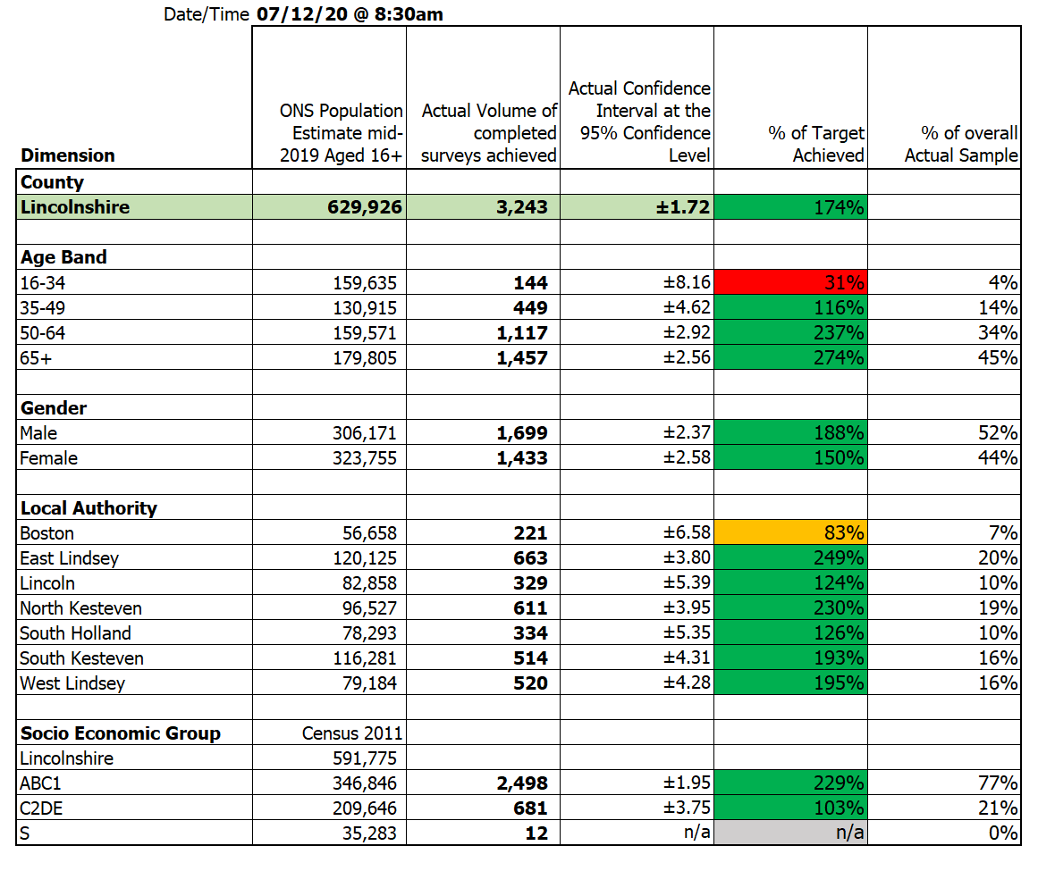
Who we needed to understand
Permanent residents of Lincolnshire
The ONS mid-year 2019 population estimate for Lincolnshire of 629,926 Adults aged 16+ was used to calculate the target sample required, in order to achieve a Confidence Interval of ±6 or better, for each of the demographic segments on the right, at the 95% Confidence Level.
The Confidence Interval for the sample as whole, at the County Level is ± 1.72 in 2020-21
(versus ± 1.70 in 2019-20).
The actual volume of completed surveys achieved are shown beside the % of the target sample achieved.
All target sample levels were met and exceeded for each segment, with the exception of 16-34 year-olds and residents
of Boston Borough.
Confidence Level & Confidence Interval
# The total target sample size was based on a
95% Confidence Level
and a minimum
Confidence Interval
by segment
(e.g. West Lindsey)
of ± 6.
This is to ensure the statistical significance of the results for each segment. It means that had we surveyed everyone in our segment population the answer to a given question would fall within 6 percentage points of our research result (in either direction) on 95 occasions
out of 100.

Slide 6
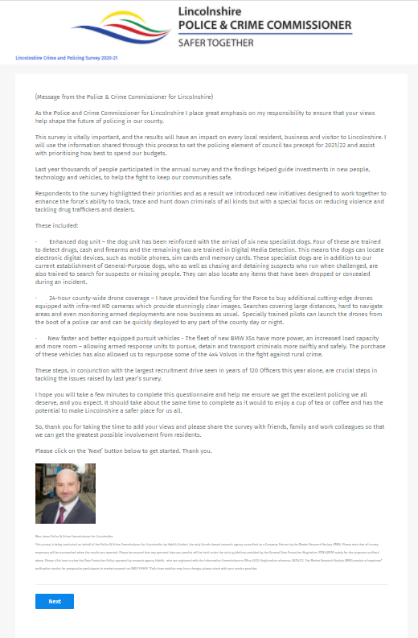
How we conducted the research
Online Quantitative Survey
An online quantitative survey was used, titled the:
‘Lincolnshire Crime and Policing Survey 2020-21’.
Sponsorship of the survey was explicitly ascribed in the introduction to Marc Jones, as Police & Crime Commissioner for Lincolnshire.
The survey was device responsive across: desktop computers, tablets and smartphones.
3,243 fully completed surveys were achieved,
just 59 fewer than in 2019-20, even though there were 10 days’ fewer in field.
All participants were qualified as being:-
16 years of age or older
Permanently resident in Lincolnshire
Fieldwork was conducted between 10th November 2020
and 7th December 2020.
All fieldwork was conducted in accordance with
the MRS Code of Conduct.

Slide 7
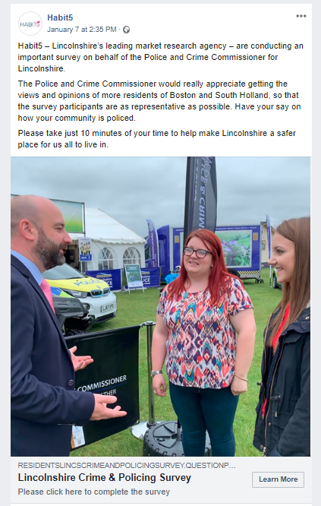
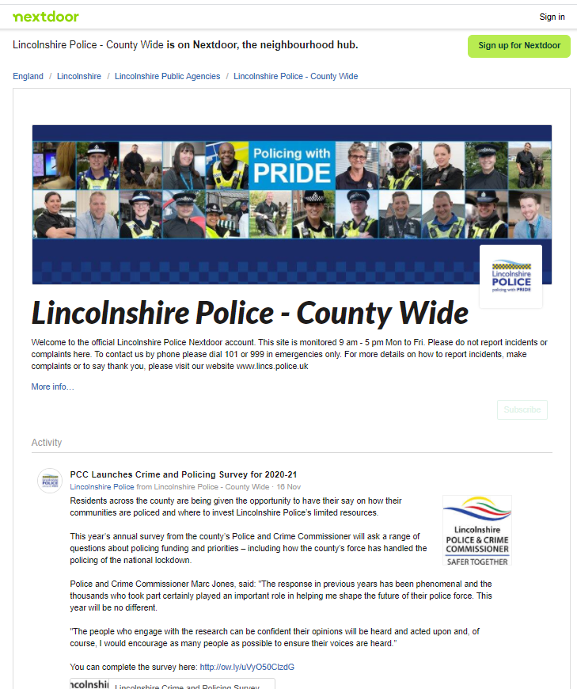
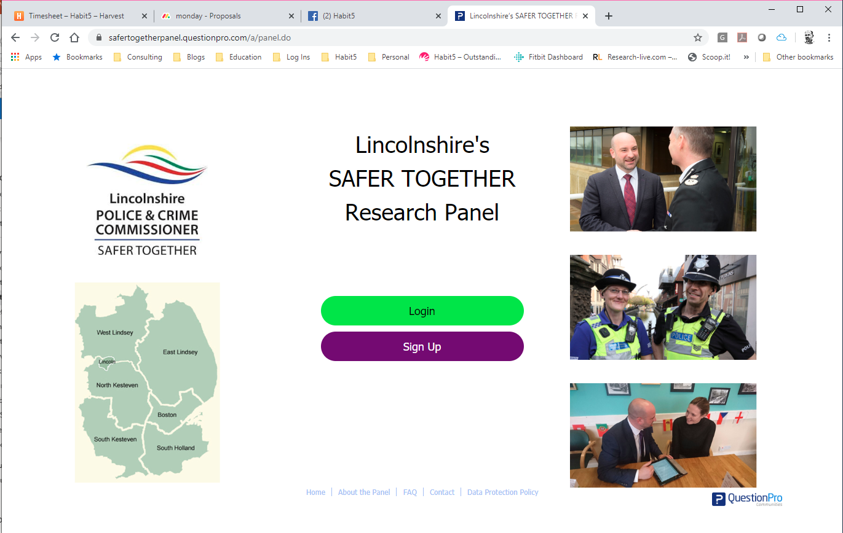
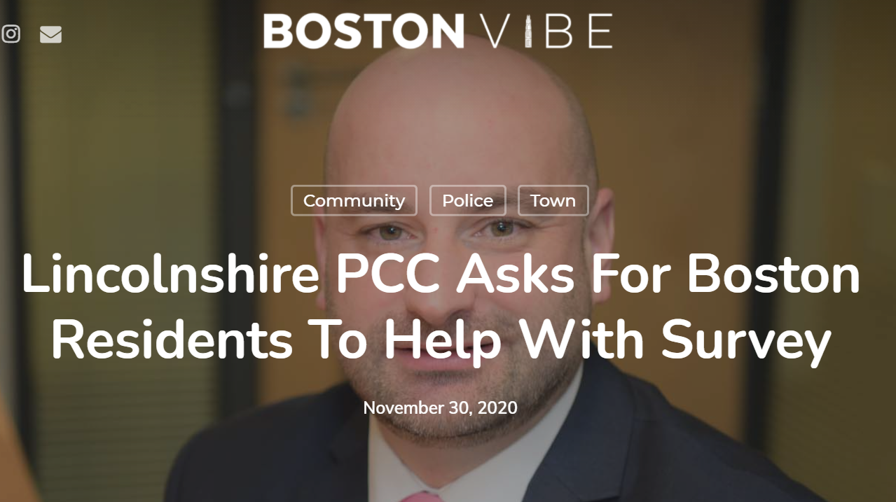

Recruiting participants
Several different media channels were deployed
In order to maximise and diversify public engagement with the survey, several different media channels were used to promote it.
SAFER TOGETHER | Lincs Alert, Next Door & affinity organisations | PR from Press Release | Facebook Promotion
All of the members of the Lincolnshire’s SAFER TOGETHER Research Panel were invited to complete the Annual Survey and 57% of them did so. | As well as a pinned tweet on Lincs PCC Twitter feed, survey invitations were sent to Lincs Alert and Next Door members. Several affinity organisations promoted the survey to their members and subscribers. | A Press Releases was issued referencing the survey. The story was picked up and featured on several news websites. | A promotional (pay-per-click) post on Facebook featuring a link to the survey was deployed & targeted to specific demographic segments: females, the under 50s and residents of Boston, each of which had proved harder to reach via other channels.

Slide 8
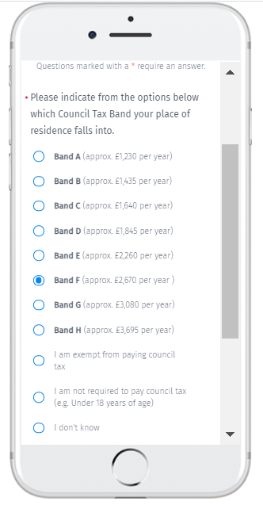
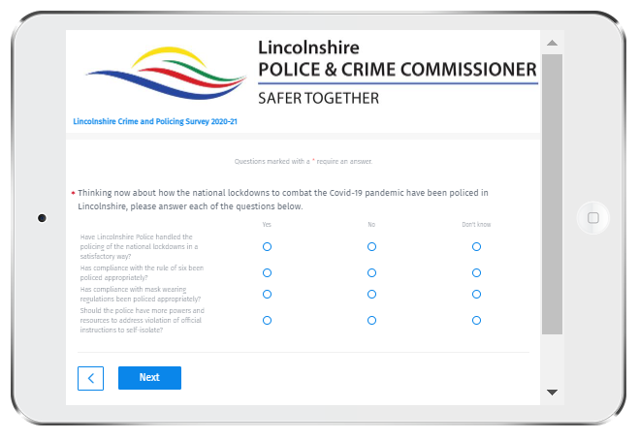
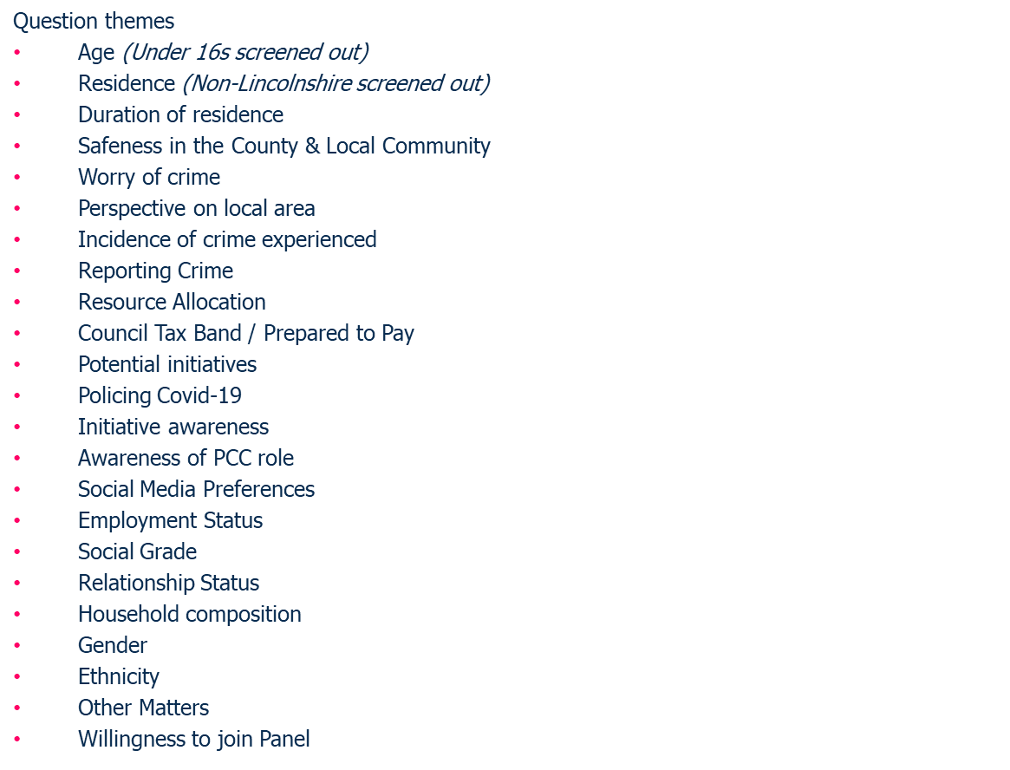
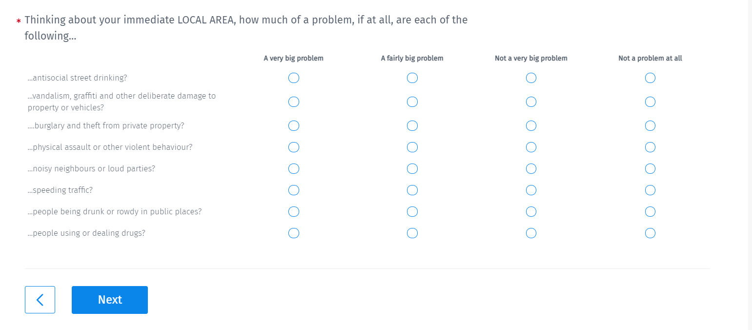
Survey structure

Slide 9
Funding for the Police and budgets
NB All survey results
shown in this presentation
relate to the
2020-21 survey unless annotated otherwise.

Slide 10
Very nearly nine out of ten participants (89%) believe that the funding for Lincolnshire Police should be increased, with just 1% believing that a reduction would be appropriate.
Do you believe that the funding for Lincolnshire Police should be...
Future Police Funding 2020
Base: Reduced (n=45), Maintained (n=320), Increased (n=2,870), Sample Size = 3,235

Slide 11
At 92% in favour, residents of Boston Borough are the most widely supportive of a funding increase with residents of Lincoln City the least likely to endorse this, but still 86% believe an increase is right.
Do you believe that the funding for Lincolnshire Police should be...
2020Lincs Police Funding by Local Authority
Base: 2020/Boston Borough (n=221), 2020/East Lindsey (n=662), 2020/Lincoln City (n=329), 2020/North Kesteven (n=611), 2020/South Holland (n=334), 2020/South Kesteven (n=514), 2020/West Lindsey (n=520), Sample Size = 3,191

Slide 12
Residents of the lower bands for Council Tax are no less supportive of an increase in funding for the Police, indeed it is actually residents in bands G and H that are less widely predisposed to an increase.
Do you believe that the funding for Lincolnshire Police should be...
Future Police Funding 2019-20
Fully 90% of residents in Band A believe that funding for Lincolnshire Police should be increased.
Base: 2020/Band A (approx. £1,100 per year) (n=532), 2020/Band B (approx. £1,300 per year) (n=539), 2020/Band C (approx. £1,480 per year) (n=701), 2020/Band D (approx. £1,650 per year) (n=652), 2020/Band E (approx. £2,000 per year) (n=330), 2020/Band F (approx. £2,380 per year ) (n=140), 2020/Band G (approx. £2,750 per year) (n=54), 2020/Band H (approx. £3,300 per year) (n=11), Sample Size = 2,959
*Care small sample.

Slide 13
93% of female participants believe that funding should be increased, compared with 86% for male participants.
Do you believe that the funding for Lincolnshire Police should be...
Future Police Funding 2020
Lincs Police Funding by Survey Year Groups by Gender
Base: Reduced (n=37), Maintained (n=305), Increased (n=2,789), Increased further (n=0), Sample Size = 3,131

Slide 14
Belief in the need for an increase in funding for Lincolnshire Police, barely fluctuates at all across the age bands, falling by just 2% when moving from 65+ participants to the under 35s.
Do you believe that the funding for Lincolnshire Police should be...
Future Police Funding 2020
Lincs Police Funding by Survey Year Groups, Age
Base: Reduced (n=45), Maintained (n=320), Increased (n=2,870), Increased further (n=0), Sample Size = 3,235

Slide 15
The distribution of answers regarding funding for the Lincolnshire Police, barely differs at all, when comparing ABC1 participants and C2DE participants. Support for an increase is just 1% higher amongst ABC1s at 89%.
Do you believe that the funding for Lincolnshire Police should be...
Future Police Funding 2020
Lincs Police Funding by Survey Year Groups, SEG Groups
Base: Reduced (n=45), Maintained (n=316), Increased (n=2,817), Increased further (n=0), Sample Size = 3,178

Slide 16
‘Theft & burglary’ and ‘Violence, disorder & anti social behaviour’ both get allocated a tenth of the available budget each, with
‘Traffic offences…’, ‘Child abuse’ and ‘Drug abuse..’ each assigned 9%.
Please imagine that you are in charge of the budgets for Lincolnshire Police. Please enter in the boxes provided below the percentage (%) of the annual budget that you would allocate to each of the categories shown.
(NB Please enter whole numbers without decimals, e.g. 5, 7, etc. Once completed the total figure at the bottom should
equal exactly '100')

Slide 17
Since the budget allocation question was last asked in 2018, the greatest increase in share is attributed to ‘Violence, disorder and antisocial behaviour’ (+3.95%). No category secures more than 10%.
Please imagine that you are in charge of the budgets for Lincolnshire Police. Please enter in the boxes provided below the percentage (%) of the annual budget that you would allocate to each of the categories shown.
(NB Please enter whole numbers without decimals, e.g. 5, 7, etc. Once completed the total figure at the bottom should
equal exactly '100')
The greatest decrease
in the share of budget
allocated between
2018 and 2020 is to
‘Terrorism & extremism’
(-3.25%).

Slide 18
The incidence of prioritisation for response to 999 emergency calls is very similar to when this question was last asked in 2018. The only difference being ‘…that their property has been broken into’ drops back by -8% and now ranks behind ‘…drug dealing taking place..’
There are significant increases in incidence of prioritisation for both ‘…that they have seen someone who is suicidal’ (Up +7% cf 2018) and ‘…a vulnerable person has gone missing’ (Up +4%).
Please imagine that you managing the deployment of police officer resource in response to 999 emergency calls received within the last few minutes. Eleven calls have come in but you only have five police officers available to deploy. Please indicate below which five calls you would deploy an officer to respond to. (Please select exactly five answer options)

Slide 19
The Precept

Slide 20
77% of participants are prepared to pay 10%+ more per week, compared with 73% in 2019 (Despite adding an additional low level 2% increase). The percentage not prepared to pay any more has fallen YOY by -7% percentage points.
Please indicate below how much more you would be prepared to pay per week, to fund
policing and crime prevention across LINCOLNSHIRE. (Please select one option)
More participants select 20% - the highest level of increase, than any other option presented to them.
Base: 2% increase (n=95), 5% increase (n=179), 10% increase (n=641), 15% increase (n=710), 20% increase (n=1,121), Not prepared to pay any more (n=417), Sample Size = 3,163

Slide 21
Perhaps through a combination of the provision of a 2% increase option and the economic impact of Covid-19, there has been a slight reduction, relative to 2019, in the average additional amount that residents are prepared to pay.
Please indicate below how much more you would be prepared to pay per week, to fund
policing and crime prevention across LINCOLNSHIRE. (Please select one option)
NB Care Band H is a very small base and consequently more volatile.

Slide 22
If those that were not prepared to pay any more are included in the calculation of the average incremental amount, then the mean amounts are very similar to those in 2019, up to Band F.
Please indicate below how much more you would be prepared to pay per week, to fund
policing and crime prevention across LINCOLNSHIRE. (Please select one option)
NB Care Band H is a very small base and consequently more volatile.

Slide 23
Amongst those residents selecting an increase, the average level chosen is 15% across all of the Bands, with the exception of H which averages out at 16%.
Please indicate below how much more you would be prepared to pay per week, to fund
policing and crime prevention across LINCOLNSHIRE. (Please select one option)
NB Care Band H is a very small base and consequently more volatile.

Slide 24
When those not prepared to pay any more are included, the average % increase across the vast majority of the Council Tax Bands is 13%, falling to 12% in Band A and dropping to 10% in Band H.
Please indicate below how much more you would be prepared to pay per week, to fund
policing and crime prevention across LINCOLNSHIRE. (Please select one option)
NB Care Band H is a very small base and consequently more volatile.

Slide 25
A 20% increase is the most widely selected option in each of the Council Tax Bands, with the exception of Band F, where 15% is favoured by 38% of participants.
2020 by Overall Precept Percentages by Council Tax Band excluding exempt, etc
Residents in Band D properties show the most widespread support for a 20% increase, with 41%
of them favouring this option.
Base: 2020/Band A (approx. £1,100 per year) (n=532), 2020/Band B (approx. £1,300 per year) (n=539), 2020/Band C (approx. £1,480 per year) (n=701), 2020/Band D (approx. £1,650 per year) (n=652), 2020/Band E (approx. £2,000 per year) (n=330), 2020/Band F (approx. £2,380 per year ) (n=140), 2020/Band G (approx. £2,750 per year) (n=54), 2020/Band H (approx. £3,300 per year) (n=11), Sample Size = 2,959
*Care very low base.

Slide 26
One third or more of residents in each Local Authority indicate that they are prepared to pay 20% more per week, with this scale of increase being most widely selected by residents of Lincoln City (40%).
Please indicate below how much more you would be prepared to pay per week, to fund policing and crime prevention across LINCOLNSHIRE.
(Please select one option)
Base: 2020/Boston Borough (n=219), 2020/East Lindsey (n=650), 2020/Lincoln City (n=307), 2020/North Kesteven (n=596), 2020/South Holland (n=330), 2020/South Kesteven (n=509), 2020/West Lindsey (n=510), Sample Size = 3,121

Slide 27
Nearly a quarter (24%) of 16-34 year-olds are resistant to any increase but a rise of 20% is still the option most widely selected (34%) amongst this younger demographic too.
Please indicate below how much more you would be prepared to pay per week, to fund
policing and crime prevention across LINCOLNSHIRE. (Please select one option)
This finding suggests that any strong resistance to an increase amongst younger residents is more likely to be about the principle that the precept is increasing at all, rather than the precise scale of the increase.
Base: 2020/16 to 34 (n=128), 2020/35 to 49 (n=436), 2020/50 to 64 (n=1,100), 2020/65+ (n=1,434), Sample Size = 3,098

Slide 28
More males (15%) are resistant to any increase than is the case amongst females (10%). Aside from this, their preparedness to pay more per week is very similar for each different level of increase.
Please indicate below how much more you would be prepared to pay per week, to fund
policing and crime prevention across LINCOLNSHIRE. (Please select one option)
Base: 2020/Female (n=1,388), 2020/Male (n=1,675), Sample Size = 3,063

Slide 29
Lack of preparedness to pay any more is higher amongst the C2DE socio-economic group (18%) when compared with ABC1 residents (12%), nonetheless 31% of them are still prepared to pay 20% more.
Please indicate below how much more you would be prepared to pay per week, to fund
policing and crime prevention across LINCOLNSHIRE. (Please select one option)
Survey Year Groups by Overall Precept Percentages, SEG Groups
Base: 2020/ABC1 (n=2,468), 2020/C2DE (n=645), 2020/Student (n=7), Sample Size = 3,120 *Care very low base.

Slide 30
Having a pronounced ‘Fear of crime’ does not correlate with a greater propensity to support an increase in funding for the police and crime prevention, indeed the opposite is true.
Please indicate below how much more you would be prepared to pay per week, to fund
policing and crime prevention across LINCOLNSHIRE. (Please select one option)
Survey Year Groups by Overall Precept Percentages, Fear of Crime Groups
Nearly a quarter of ‘Fearful’ residents (24%) are not prepared to pay
any more.
This finding merits further investigation but could be the result of some fearful residents feeling that the police have failed them in some way.
Base: 2020/Not Fearful (n=1,585), 2020/Anxious (n=1,318), 2020/Fearful (n=260), Sample Size = 3,163

Slide 31
In 2020, resistance to any increase is less widespread (13%) than in any previous year, but support for the highest level of increase has also dropped (back to the level it was at in 2017 of 35%).
Please indicate below how much more you would be prepared to pay per week…
(Please select one option)
NB The addition of the 2% increase level in 2020 is likely to have drawn the levels of endorsement for 5% down and may have encouraged a slight general drift to a lower level of increase, particularly the 10% more option. Conversely, it may have contributed to the reduction in resistance to any increase at all.

Slide 32
Preparedness to pay 10% more, rose sharply in 2020, being selected by a fifth of participants. It may have benefited from being a
mid-point in the proposed increase levels.
Please indicate below how much more you would be prepared to pay per week…
(Please select one option)
Aside from the 10% more option and the new 2% increase option, incidence of endorsement fell for all of the other levels of increase and unpreparedness to pay any more.

Slide 33
Fear of crime
& worry by type of crime

Slide 34
2020 has seen a drift towards ratings of 3 and 4 for ‘Fear of Crime’ and reductions for the high effect indicated by a rating of 5 and over and at 1 for no effect.
How much is YOUR OWN quality of life affected by FEAR OF CRIME on a scale from 1 to 10,
where 1 is no effect and 10 is a total effect on your quality of life?
Fear of Crime by Survey Year Groups
NB In 2019 we asked a question regarding ‘feeling safe’ rather than about ‘fear’.
2020 has, as we all know, been a challenging and very unusual year.
The drift in ratings here may reflect some general unease and anxiety but perhaps not about crime and policing per se.
Base: 1 (n=997), 2 (n=1,775), 3 (n=1,823), 4 (n=1,037), 5 (n=1,341), 6 (n=788), 7 (n=767), 8 (n=665), 9 (n=206), 10 (n=186), Sample Size = 9,585

Slide 35
The mean score for fear of crime in 2020 at 4.04 is more positive than in the previous years’ where this question was asked.
How much is YOUR OWN quality of life affected by FEAR OF CRIME on a scale from 1 to 10,
where 1 is no effect and 10 is a total effect on your quality of life?
Fear of Crime by Survey Year Groups Mean Score
NB The closer the mean gets to a rating of ‘1’ indicates an improving position.
Base: 2017 (n=2,905), 2018 (n=3,444), 2020 (n=3,236), Sample Size = 9,585

Slide 36
Residents that are ‘Fearful’ are much more likely to fall within the C2DE socio-economic group and/or live in Boston Borough.
Residents who are ‘Not worried’ are more likely to be ABC1 and/or live in North Kesteven.
How much is YOUR OWN quality of life affected by FEAR OF CRIME on a scale from 1 to 10,
where 1 is no effect and 10 is a total effect on your quality of life?
SEG Groups by Survey Year Groups, Fear of Crime Groups
Rating | Segment
8-10 | Fearful
4-7 | Anxious
1-3 | Not Worried
Participants categorised as ‘Anxious’ are more likely to be female and/or live in South Holland.

Slide 37
Residents of North Kesteven are the least likely to be affected by Fear of Crime, whereas 53% of residents in Boston give a rating of 5 or more.
How much is YOUR OWN quality of life affected by FEAR OF CRIME on a scale from 1 to 10,
where 1 is no effect and 10 is a total effect on your quality of life?
Base: 2020/Boston Borough (n=221), 2020/East Lindsey (n=662), 2020/Lincoln City (n=329), 2020/North Kesteven (n=611), 2020/South Holland (n=334), 2020/South Kesteven (n=514), 2020/West Lindsey (n=520), Sample Size = 3,191

Slide 38
Propensity to be ‘Anxious’ or worse, tends to diminish the higher up the Council Tax Bands you go.
How much is YOUR OWN quality of life affected by FEAR OF CRIME on a scale from 1 to 10,
where 1 is no effect and 10 is a total effect on your quality of life?
NB Care Band H is a very small base and consequently more volatile.
Base: 2020/Band A (approx. £1,100 per year) (n=532), 2020/Band B (approx. £1,300 per year) (n=539), 2020/Band C (approx. £1,480 per year) (n=701), 2020/Band D (approx. £1,650 per year) (n=652), 2020/Band E (approx. £2,000 per year) (n=330), 2020/Band F (approx. £2,380 per year ) (n=140), 2020/Band G (approx. £2,750 per year) (n=54), 2020/Band H (approx. £3,300 per year) (n=11), Sample Size = 2,959 Excludes exempt and Don’t Know.

Slide 39
‘…being a victim of identity theft’ and/or ‘…being a victim of online or cyber crime’ attract the mot widespread worry amongst residents with, in each case, 64% of people being ‘very or fairly worried’.
Most of us worry at some time or other about being the victim of a crime. Please indicate how worried you are or aren't about each of the following... (Please provide an answer for each row)
‘Having your home broken into and something stolen’ is very clearly the third most widespread worry, with 60% of people ‘very or fairly worried’ about this.
Base: ...having your home broken into and something stolen? (n=3,235), ...being mugged or robbed? (n=3,235), ...having your car stolen? (n=3,235), ...having things stolen from your car? (n=3,235), ...being raped or sexually assaulted? (n=3,235), ...being physically attacked by strangers? (n=3,235), ...being a victim of online or cyber crime? (n=3,235), ...being a victim of identity theft? (n=3,235), Sample Size = 3,235

Slide 40
Over the course of the four years that we have run the
Annual Survey, cyber crime and identity theft have overtaken domestic burglary as the most widespread worries.
Most of us worry at some time or other about being the victim of a crime. Please indicate how worried you are or aren't about each of the following...
(Please provide an answer for each row)

Slide 41
Local problems
& experience of crime

Slide 42
As in previous years ‘Speeding traffic’, is by far the most widely experienced problem, with 64% of participants regarding this as a ‘very big’ or ‘fairly big’ problem in their local area.
Thinking about your immediate LOCAL AREA, how much of a problem, if at all,
are each of the following...
Local Problems 2020
‘…people using or dealing drugs’ is the second most widespread problem, with 35% of participants seeing it as a ‘very or fairly big’ problem in their
local area.
Base: ...noisy neighbours or loud parties? (n=3,236), ...antisocial street drinking? (n=3,236), ...vandalism, graffiti and other deliberate damage to property or vehicles? (n=3,236), ....burglary and theft from private property? (n=3,236), ...people using or dealing drugs? (n=3,236), ...people being drunk or rowdy in public places? (n=3,236), ...physical assault or other violent behaviour? (n=3,236), ...speeding traffic? (n=3,236), Sample Size = 3,236

Slide 43
The perception that ‘Speeding traffic’ is a ‘very big’ or ‘fairly big’ problem is most widespread in South Holland (74%) followed by residents of Boston Borough (69%).
Thinking about your immediate LOCAL AREA, how much of a problem, if at all,
are each of the following...
Survey Year Groups by ...speeding traffic?, Local Authority
Base: 2020/Boston Borough (n=221), 2020/East Lindsey (n=662), 2020/Lincoln City (n=329), 2020/North Kesteven (n=611), 2020/South Holland (n=334), 2020/South Kesteven (n=514), 2020/West Lindsey (n=520), Sample Size = 3,191

Slide 44
Residents of Boston Borough are most likely (55%) to regard ‘…people using or dealing drugs’ as a ‘very big’ or ‘fairly big’ problem in their local area, with North Kesteven the least likely to do so (27%).
Thinking about your immediate LOCAL AREA, how much of a problem, if at all,
are each of the following...
Survey Year Groups by ...people using or dealing drugs?, Local Authority
Base: 2020/Boston Borough (n=221), 2020/East Lindsey (n=662), 2020/Lincoln City (n=329), 2020/North Kesteven (n=611), 2020/South Holland (n=334), 2020/South Kesteven (n=514), 2020/West Lindsey (n=520), Sample Size = 3,191

Slide 45
With the exceptions of ‘…speeding traffic’ and ‘…noisy neighbours’ all other forms of potential problem are perceived to be less of an issue in 2020 – Is this, in part, down to the impact of Covid-19 restrictions?
Thinking about your immediate LOCAL AREA, how much of a problem, if at all,
are each of the following...
Local Area Mean Scores by Survey Year Groups

Slide 46
Exactly a third of participants indicate that either they personally or a member of their household, have experienced at least one form of crime or incident within the last 12 months (-3% .v. 2019)
Within the last 12 months specifically, have you personally
or has anyone in your household experienced any of the following...
Crime Experience by Survey Year Groups
Experience of crime peaks amongst
16-34 year-olds (38%),
the C2DE socio-economic group (37%) and residents of Boston Borough (42%).
Base: ...had a car, van, motorcycle, or other motor vehicle stolen? (n=70), ...had anything stolen, off or from inside, a vehicle? (n=237), ...had anything stolen from your home? (n=236), ...had any personal possessions stolen whilst in a public place? (n=196), ...been physically attacked by another person? (n=274), ...been threatened in any way? (n=980), ...been subject to online crime, cyber crime and/or identity theft? (n=837), ...been subject to telephone fraud (n=800), None of the above (n=4,226), Sample Size = 6,535

Slide 47
Over a fifth (21%) of Non White British participants indicate that they, or a member of their household, have been threatened in some way within the last 12 months.
Within the last 12 months specifically, have you personally or has anyone in your household experienced any of the following...
Crime Experience by 2020 Ethnic Grouping
‘Non White British’ participants are more likely to indicate experience of each type of crime researched, with the exception of theft from the person and/or of
a motor vehicle.

Slide 48
Whilst a lot of care needs to be exercised, as it is a very small sample base, a much higher proportion of Students (42% +29 .v. total sample) indicate that they, or a member of their household, has been threatened.
Within the last 12 months specifically, have you personally or has anyone in your household experienced any of the following...
Crime Experience by 2020 SEG Groups

Slide 49
‘Being threatened’ is the event most likely to be experienced more than once (53%), very closely followed by cyber crime/identity theft (51%), other types of events are experienced once in 65%+ of cases.
How many times, within the last 12 months, did each of the events listed below happen to you PERSONALLY or a member of your household..
Crime incidence 2020
Base: ...had a car, van, motorcycle, or other motor vehicle stolen? (n=24), ...had anything stolen, off or from inside, a vehicle? (n=88), ...had anything stolen from your home? (n=100), ...had any personal possessions stolen whilst in a public place? (n=60), ...been physically attacked by another person? (n=98), ...been threatened in any way? (n=419), ...been subject to online crime, cyber crime and/or identity theft? (n=416), Sample Size = Variable

Slide 50
The nature of the threatening behaviour is largely unchanged from when we last researched it in 2018.
You indicated earlier in the survey, that within the last 12 months specifically, you PERSONALLY or someone else in your household, had been threatened. What form did this threatening behaviour take?
(Please tick all of the answer options that apply)
Threatening Behaviour by Survey Year Groups
Fewer participants experiencing threatening behaviour reference ‘Cyberbullying’ (-4%) whilst slightly more of them reference
‘Threat of violence to the individual concerned’ (+4%).
Base: General verbal abuse (n=798), Threat of violence to the individual concerned (n=466), Threat of violence to a family member, friend or relation (n=259), Threat of violence or damage to possessions or property (n=297), Threat of blackmail or extortion (n=67), Cyberbullying (n=93), Stalking or harassment (n=186), None of the above (n=1), Sample Size = 1,135

Slide 51
Amongst those experiencing online crime, a higher proportion of them cite a ‘scam or fraud’ (74% +16% .v. 2018) and ‘phishing’ (63% +14% .v. 2018).
You indicated earlier in the survey, that within the last 12 months specifically, you PERSONALLY or someone else in your household, had been subject to online crime, cyber crime and/or identity theft. Please indicate what happened by selecting the relevant options from the list below? (Please tick all of the answer options that apply)
Base: Malware or computer virus: presence of software designed to disrupt, damage, or gain unauthorized access to a computer system (n=273), Phishing: use fake email messages in an attempt to get personal information from internet users (n=540), Identity theft: Misuse of personal information to impersonate another individual (n=217), Online scam or fraud (n=639), Hacking: unauthorised access to, or control over, computer network security systems for an illicit purpose (n=182), Cyberbullying: the use of electronic communication to bully a person, typically by sending messages of an intimidating or threatening nature (n=84), Grooming: making sexual advances to a minor(s) (n=7), Online incitement of racial hatred, violence or terrorism (n=24), Distribution of indecent images e.g. sexting (n=11), None of the above (n=30), Sample Size = 1,002

Slide 52
Reporting crime

Slide 53
Exactly a quarter of participants had reported a crime or incident to Lincolnshire Police within the last 12 months, representing a reduction of 3% on the equivalent measure in 2018.
Have you reported a crime(s) or incident(s) to Lincolnshire Police within the last 12 months?
Base: Yes (n=1,778), No (n=4,900), Sample Size = 6,678

Slide 54
Around a third of participants aged 16-49, Students, and/or residents of Boston Borough, Lincoln City or South Holland, indicated that they had reported at least one crime or incident within the last 12 months.
Have you reported a crime(s) or incident(s) to Lincolnshire Police within the last 12 months?
Less than a fifth of the over 65s, and/or residents of North Kesteven, reported a crime or incident within
the last 12 months.

Slide 55
Use of online reporting appears to have increased by 5% percentage points since 2018, representing an increase of a third on two years’ ago.
How did you report the crime(s) or incident(s) to Lincolnshire Police? (Please tick all options that apply)
Is the scale of increase in online reporting over the last 24 months reflected in your actual experience with www.lincs.police.uk?

Slide 56
Satisfaction levels are highest for reporting by ‘calling 999’ (56%), followed by ‘to an officer in person’ (51%) whereas dissatisfaction peaks for ‘At a police station in person’ (49%).
Please use the rating scale below to indicate how satisfied or dissatisfied you were overall, with your experience of using the method(s) listed to report crime(s) or incident(s) to Lincolnshire Police.
Report Method Satisfaction
Base: Called 999 (n=148), Called 101 (n=507), Used online reporting (e.g. at www.lincs.police.uk ) (n=151), Via social media (e.g. Facebook, Twitter, etc @lincspolice) (n=33), To a police officer in person (n=104), At a police station in person (n=51), Via Neighbourhood Watch (n=17), Via Crimestoppers (n=20), Other (n=59), Sample Size = Variable

Slide 57
The mean scores for satisfaction with reporting have improved since 2018 for ‘called 999’ and ‘called 101’, whilst deteriorating over that same time period for many of the other channels.
Please use the rating scale below to indicate how satisfied or dissatisfied you were overall, with your experience of using the method(s) listed to report crime(s) or incident(s) to Lincolnshire Police.
Base: Called 999 (n=392), Called 101 (n=1,208), Used online reporting (e.g. at www.lincs.police.uk ) (n=312), Via social media (e.g. Facebook, Twitter, etc @lincspolice) (n=67), To a police officer in person (n=248), At a police station in person (n=152), Via Neighbourhood Watch (n=55), Via Crimestoppers (n=38), Other (n=203), Sample Size = Variable

Slide 58
Reporting Free Text Question: At the previous question you indicated that you were dissatisfied with one or more of the methods that you used. Please briefly describe in the text box below why that is.
Shop theft is out of control , police do not do anything anymore too much of an issue to investigate and people just get away with it
the young gangs in my area are constantly damaging property..peoples belongings, local amenities taking drugs..nothing is done..we never see the Police walking in the area
The process was too long winded, we needed to get a police officer out to some youths riding an unlicensed motorcycle, it took so long they would have missed them.
The response time to the first incident (999) was nearly 20hrs, whilst being told it was being 'blue lighted'. The response to 101 was 3hrs. The disproportionate responses were abysmal and resulted in my wife and daughter having panic attacks. I am more than happy to discuss with the Commissioner.
Police don’t care, They are underfunded and haven’t got the resources.
Spoke with a local PCSO who appeared disinterested, didnt note any details and just kept telling me stats and how short staffed you are
Phones up, reported my children’s quad bike as stolen, I got given a crime number and they said an officer will give me a call.. never received any phone call, no follow up, nobody willing to retrieve the quad bike. Thankfully Gainsborough is a small town and I found out who stole my children’s quad bike.
Police Officer didn't get back to me after his visit and was supposed to follow things up through a PCSO arranging to see me - did not happen !
Officers attending and responding to the incidents just trying to defuse situation instead solving the problems. It is more counseling session than policing. And saddest thing is Lincolnshire policing with pride.. sorry but nothing to be proud of
THe lincs police online reporting web form is terrible, please copy the crimestopper format
Call handler unsympathetic When calling in to report party in lockdown re noise swearing kids on premises was told to buy ear defenders!
Calling 101 is generally a waste of time. I've had mixed results, but often after following instructions I get cut off and end up annoyed and frustrated.

Slide 59
Unsurprisingly, calling 999 is the most likely method to report a crime or incident in a future emergency for 58% of participants, significant numbers select ‘to a police officer in person’ (19%) or ‘at a police station’ (12%).
If you had to report a crime or incident in the future which method would you be most likely to use: in an emergency and for a non-urgent matter? (Please select one answer option only in each column)
Emergency Reporting by Survey Year Groups % Mentions
Material to the answers here will be where participants imagine themselves being when this emergency occurs.
Offering answers that include ‘to a police officer in person’ or ‘at a police station in person’ may encourage a sense of proximity to these options.
Base: Call 999 (n=3,181), Call 101 (n=103), Use online reporting (e.g. at www.lincs.police.uk ) (n=57), Via social media (e.g. Facebook, Twitter, etc @lincspolice) (n=29), To a police officer in person (n=1,034), At a police station in person (n=680), Via Neighbourhood Watch (n=79), Via Crimestoppers (n=169), Other (n=128), Sample Size = 3,236

Slide 60
The most likely method to be used to report a non-urgent matter are much more varied. Calling 101 is selected by a fifth of participants, with using online reporting the next most widely selected option (16%).
If you had to report a crime or incident in the future which method would you be most likely to use: in an emergency and for a non-urgent matter? (Please select one answer option only in each column)
Non urgent reporting % Mentions
Participants tend to favour reporting options for non urgent matters that optimise the perceived time
(duration and convenience) and effort
(spatial/location, etc) involved for them.
Base: Call 999 (n=35), Call 101 (n=2,932), Use online reporting (e.g. at www.lincs.police.uk ) (n=2,359), Via social media (e.g. Facebook, Twitter, etc @lincspolice) (n=1,876), To a police officer in person (n=1,068), At a police station in person (n=1,452), Via Neighbourhood Watch (n=1,856), Via Crimestoppers (n=1,765), Other (n=1,412), Sample Size = 3,236

Slide 61
Initiatives

Slide 62
93% of participants support the use of ANPR cameras in their area and nearly as many (85%) would support increased use of these devices.
86% of participants back more action on substance misuse.
Thinking about current and potential initiatives by Lincolnshire Police.
Do you support...
Base: ...the current use of automatic number plate recognition cameras (ANPR) in your area to identify vehicles linked to crime? (n=3,236), ...the increased use of automatic number plate recognition cameras (ANPR) in your area to identify vehicles linked to crime? (n=3,236), ...more action being taken to address the issues of substance misuse, supply and related crime in your community? (n=3,236), Sample Size = 3,236

Slide 63
Awareness of many initiatives or programmes appears to have fallen back slightly in 2020; some of the messaging here may have been overshadowed by Covid-19 campaigns and communications.
Which, if any, of the initiatives or programmes listed below, were you aware of, before
starting to complete this survey (Please tick all that apply).
Initiative Awareness

Slide 64
Policing the Covid-19 restrictions

Slide 65
Nearly two thirds of participants (64%) believe that the police should have more powers and resources to address violation of official instructions to self-isolate.
Thinking now about how the national lockdowns to combat the Covid-19 pandemic have been policed in Lincolnshire, please answer each of the questions below.
Covid-19 specific
Whilst the majority of participants do not offer an opinion, less than a fifth of participants believe that compliance with mask wearing and the rule of six has been policed appropriately, with a higher proportion belieiving the opposite.
Base: Have Lincolnshire Police handled the policing of the national lockdowns in a satisfactory way? (n=3,235), Has compliance with the rule of six been policed appropriately? (n=3,235), Has compliance with mask wearing regulations been policed appropriately? (n=3,235), Should the police have more powers and resources to address violation of official instructions to self-isolate? (n=3,235), Sample Size = 3,235

Slide 66
Interestingly, both satisfaction and dissatisfaction with the way the rule of six has been policed decreases with age – Perhaps as a result of the younger age cohorts having more experience and/or exposure to hearsay on this and therefore feeling able to offer an opinion?
Has compliance with the rule of six been policed appropriately?
Age by Rule of six
Base: 16 to 34 (n=144), 35 to 49 (n=449), 50 to 64 (n=1,117), 65+ (n=1,457), Sample Size = 3,167

Slide 67
More males are likely to offer an opinion on how mask wearing has been policed and a higher proportion of those that do, think that it has not been appropriately policed.
Has compliance with mask wearing regulations been policed appropriately?
Gender by Mask wearing
Base: Female (n=1,432), Male (n=1,699), Sample Size = 3,131

Slide 68
Residents of Boston Borough are much less likely to believe that Lincolnshire Police have handled the national lockdown in a satisfactory way (39% disagree), whereas more than twice as many residents of North Kesteven are satisfied (34%) as disagree (16%).
Have Lincolnshire Police handled the policing of the national lockdowns in a satisfactory way?
Base: South Holland (n=334), Boston Borough (n=221), South Kesteven (n=514), East Lindsey (n=662), West Lindsey (n=520), Lincoln City (n=329), North Kesteven (n=611), Sample Size = 3,191

Slide 69
Over two thirds of the participants who believe police funding should be increased also believe the police should have more powers and resources to address violation of official instructions to self-isolate – they support the means, as well as will the ends.
Should the police have more powers and resources to address violation of official instructions to self-isolate?
Base: Reduced (n=45), Maintained (n=320), Increased (n=2,870), Sample Size = 3,235

Slide 70
Witnessing non-compliance and concerns regarding the ability to enforce restrictions (both beat officers and resources) collectively account for very nearly 60% of dissatisfaction with the way that the lockdowns have been policed.
Policing Lockdown Free Text Question: At the previous question you indicated some dissatisfaction with how Lincolnshire Police have handled one or more aspects of the national lockdown, please could you briefly explain why in the space provided below.

Slide 71
Examples for ‘Insufficient Police’
Not enough officers on the beat to police people not following Coronavirus rules
No visible presence to turn back holiday makers/caravans travelling to the coast during lockdown; no removal of illegal camper vans from huttoft bank; no visible police walking around to help shop owners requesting shoppers wear masks; no random stopping of vehicles to check occupants acting within rules. In fact I haven’t seen a police officer other than one in a car flying past for years.
Not seen a single police officer when there have been illegal gatherings of people with no masks and not social distancing a constant sight in Boston town centre and SPALDING town centre.
Literally no one cares, you go to the shops and no one is distancing or wearing masks and it makes you feel like you are the only one taking it seriously. Police are never seen out and about so do nothing about it
I am sure this is all about a lack of resources rather than a lack of will but there are people not observing the rule of six, not wearing face coverings in shops etc. with apparent impunity. More visible policing around shops might have helped this. The message that seemed to come out when the face covering in shops became mandatory was that the police wouldn't get involved unless it resulted in an assault or a public order offence - not very helpful.
I experienced the first lockdown in Spain having gone to care for my parents and getting stuck there. Guardia Civil were ever present, there were road blocks stopping us at strategic points to check the purpose of our journey. I personally got stopped in the car 5 times on my way to or from the hospital. This did not bother me as I was conducting permitted travel. Guardia did spot checks on supermarkets to check people were visiting their nearest supermarket. The fines were very high (up to €30000) for breaking the rules. I appreciate that their funding is probably different and that the Guardia Civil have more powers than our police do. However their presence made me feel safe. I have never even seen a police car, never mind an actual member of the police on our streets during this lockdown in UK.
I'm generally happy with our police force, but know they are underfunded and understaffed. Hence , handling the covid situation has been difficult for them in terms of checking if everyone follows the guidelines

Slide 72
Examples for ‘No Action Taken’
Continuing groups of youths in groups of 20 or more with no social distance or masks in public parks.
Groups of young people gathering inside and outside with no distancing or masks. Ignoring the dangers, to others.
Have not been willing to step in an enforce rules. People breaking restrictions are visible everywhere.
I don't travel far from my home these days but when I do go out I see groups of people not distancing, not wearing masks and I see and hear of people visiting homes other than their own. I rarely hear of any enforcement or fines imposed
I have seen no evidence that Lincolnshire police have taken any action in places where the rules have been violated in public places
A neighbour reported a breach of lockdown rules during the summer when a large party was observed at a neighbour's house/garden Reported to police. Nobody came. Breaches of the lockdown rules can impact us all. I believe breaches should be treated very seriously
Because they have refused to enforce the law to ensure people comply. I have watched them since March just sitting in a police van in Market Square in Boston while groups of people have been congregating by HSBC and they have not moved them on, approached them or questioned them. They have not been visible every day in the town or surrounding areas to ensure masks are being worn, social distancing is adhered to and have refused to help shopkeepers out when people are harassing them about entering a shop without a mask. All of this, yet they are prepared to stand along Sleaford Road armed with radar guns to try and get speeders. Im sorry, but in these times they need to get their priorities straight and deal with people breaking the law regarding Covid19 rather than taking the easy way out and persecuting the motorists yet again.
Groups of people gathering in public places and a Police car driving past not stopping to break them up
Large Groups of foreigners hanging in town centre no masks and I’ve seen police officer just walk past them
PCSO's being the only police presence in our area & openly avoiding challenging situations
They have been largely invisible during the periods, and when present where some members of the public are flouting the rules and recommendations they have stood by and done nothing

Slide 73
Awareness of the role

Slide 74
It would appear that around 85% of participants who are aware of the position of PCC, know that Marc Jones is the current incumbent – on a prompted basis at least.
Prior to completing this survey today, please indicate whether or not you were aware of each of the following... (Please provide an answer for each row)
Fewer than a third of participants (29%) claim to already have been aware of the cost saving arising from the introduction of the PCC role, even when
prompted with it.
Base: The position of Lincolnshire Police & Crime Commissioner (PCC) (n=3,235), That Marc Jones is the current Police & Crime Commissioner for Lincolnshire (n=3,235), That the role of the PCC is to be the voice of the people and hold the police to account (n=3,235), That the purpose of the PCC is to influence and provide a link to national policy on criminal justice, policing and victim support (n=3,235), That the PCC is responsible for holding and spending the total police budget (n=3,235), That the Office of Police and Crime Commissioner receives funding to commission and oversee victim services for the county (n=3,235), That the introduction of the PCC role replaced the Police Authority saving £170,000 per annum in Lincolnshire (n=3,235), Sample Size = 3,235

Slide 75
Prompted awareness of the position of Lincolnshire PCC appears to have increased by +6% since 2017 to 82% in 2020.
Prior to completing this survey today, please indicate whether or not you were aware of each of the following... (Please provide an answer for each row)
Survey Year Groups by The position of Lincolnshire Police & Crime Commissioner (PCC)
Base: 2017 (n=2,905), 2018 (n=3,445), 2019 (n=3,302), 2020 (n=3,235), Sample Size = 12,887

Slide 76
Prompted awareness of Marc Jones as the current PCC has increased by +15% since 2017 to 70% in 2020.
Prior to completing this survey today, please indicate whether or not you were aware of each of the following... (Please provide an answer for each row)
Survey Year Groups by That Marc Jones is the current Police & Crime Commissioner for Lincolnshire
Base: 2017 (n=2,905), 2018 (n=3,445), 2019 (n=3,302), 2020 (n=3,235), Sample Size = 12,887

Slide 77
Media channel use
and preference

Slide 78
Exactly half of the participant base indicated that they use Facebook everyday, with 80% using this social media channel at least occasionally – it dwarfs the usage of the other media channels.
How regularly, if at all, do you use the following media channels?
Social Media Useage 2020
Next Door would appear to be building usage quite quickly with 22% of participants indicating that they use this channel at least on a weekly basis.
Base: Facebook (n=3,235), Twitter (n=3,235), Linkedin (n=3,235), Next Door (n=3,235), Lincs Alert (n=3,235), Sample Size = 3,235

Slide 79
60% of female participants use Facebook everyday, compared with 43% of male participants. Males use Twitter, Linkedin and Lincs Alert more widely and more frequently than females do.
How regularly, if at all, do you use the following media channels?
Social Media Usage 2020

Slide 80
Facebook represents the preferred media channel to receive information and news about policing and community safety for
42% of participants, followed by 18% favouring Lincs Alert
and 10% Next Door.
What would represent your preferred media channel to receive
information and news about policing and community safety?
Base: Facebook (n=1,373), Twitter (n=252), Linkedin (n=28), Next Door (n=338), Lincs Alert (n=586), Other (n=303), None of the above (n=355), Sample Size = 3,235

Slide 81
Facebook is the most widely preferred media channel for receiving information and news about policing, etc among participants in each age band but this decreases with age, whereas preference for
Lincs Alert increases with age.
What would represent your preferred media channel to receive
information and news about policing and community safety matters?
Preferred Media Channel by Age
Base: Facebook (n=1,347), Twitter (n=245), Linkedin (n=28), Next Door (n=334), Lincs Alert (n=572), Other (n=292), None of the above (n=349), Sample Size = 3,167

Slide 82
Female participants more widely preference Facebook and Next Door, whereas male participants more widely preference Twitter
and Lincs Alert.
What would represent your preferred media channel to receive
information and news about policing and community safety matters?
Preferred Media Channel by Gender
Base: Facebook (n=1,335), Twitter (n=240), Linkedin (n=28), Next Door (n=331), Lincs Alert (n=568), Other (n=295), None of the above (n=334), Sample Size = 3,131

Slide 83
Interest in joining the Panel

Slide 84
636 survey participants (20%) expressed interest in joining the
Lincolnshire’s SAFER TOGETHER Research Panel and provided their contact details in order to be supplied with further information.
If you are interested in joining the Panel, please enter your contact details below and you will be provided with information on how to 'Sign Up' and help make Lincolnshire a safer place for everyone.
2020 Expressed Interest in the Panel by Gender
An increase of +158 in those interested in joining the Panel versus 2019.

Slide 85
The vast majority of participants expressing an interest in joining the Research Panel are aged 50+.
If you are interested in joining the Panel, please enter your contact details below and you will be provided with information on how to 'Sign Up' and help make Lincolnshire a safer place for everyone.
2020 Expressed Interest in the Panel by Age Band

Slide 86
100+ participants who are resident in: East Lindsey (133),
North Kesteven (113) and South Kesteven (100), expressed an interest in joining the Research Panel.
If you are interested in joining the Panel, please enter your contact details below and you will be provided with information on how to 'Sign Up' and help make Lincolnshire a safer place for everyone.
2020 Expressed Interest in the Panel by Local Authority
Ways to boost or tap interest amongst residents of
Boston Borough
should be explored.

Slide 87
Sample profile

Slide 88
Sample variation from the resident population of Lincolnshire
As detailed within the Background section, we set minimum target sample volumes by:
Gender
Age Band
Local Authority
Socio Economic Group (e.g. ABC1, C2DE)
We did not cap sample at these minimum volumes, as we wished to engage and enfranchise as many people as possible. In 2020/21 we were again utilising channels that could not simply be ‘switched off’ (e.g. Lincs Alert, PR, affinity groups, etc). We therefore have higher overweight positions within demographic segments who exhibit a greater propensity to engage in completing the survey.
Within analysis we have the option to:
A] Use the largest sample possible, if isolating results amongst a particular demographic
(e.g. 35-49 year-olds). NB We have sought to use this option more widely in 2020-21.
B] Use the total sample available
C] Use a weighted sample to reflect the distribution of the actual population of Lincolnshire on a given demographic, rather than their incidence in the total sample population, e.g. examining results re-calibrating age band to adjust for our overweight amongst 50+ year-olds

Slide 89
The ratio of Males to Females participating has reverted to the mean from the first two years’ of running the survey, in part because the shorter fieldwork period afforded less time to respond to this.
Gender by Survey Year
Base: Female (n=5,904), Male (n=6,593), Non binary / third gender (n=36), Prefer not to say (n=274), Prefer to self-describe (please complete box below) (n=14), Sample Size = 12,821

Slide 90
The proportion of participants over 65 rose significantly to 45% in the 2020 Survey, whereas the proportion of 16-34 year-olds participating fell sharply to 4%.
What is your age? (Please select one option only)
Age Band
Greater emphasis will need to be placed on participant recruitment sources that engage the under 50s and the under 35s in particular.
The volume of survey completes by under 35s delivered by the major sources: Lincs Alert, Nextdoor and the Panel are very low indeed.
Base: 16 to 34 (n=1,530), 35 to 49 (n=2,443), 50 to 64 (n=4,235), 65+ (n=4,596), Unknown (n=84), Sample Size = 12,888

Slide 91
The ethnic mix of participants’ is again virtually unchanged from previous years. 93% of the participant sample self-categorising as White British continues to mirror what we currently know about the resident population.
What is your ethnic group?
Ethnicity 2020-21

Slide 92
A slightly higher proportion (+4% on 2019) of participants live in households comprising two adults, whilst the proportion being the sole adult in the household is unchanged at 19%.
How many adults aged 18 or over, including yourself, live in your household?
Number of Adults in Household
Base: 1 (n=1,771), 2 (n=6,285), 3 (n=988), 4 (n=323), 5 (n=109), Sample Size = 9,476

Slide 93
The number of participants living in a household that includes at least one child or young person, fell by 6% in 2020, compared with 2019, reflecting the older profile of participants.
How many children and young people, aged 17 and under, live in your household?
Number of under 18s in household
Base: 1 (n=8,018), 2 (n=943), 3 (n=739), 4 (n=210), 5 (n=46), 6 (n=24), Sample Size = 9,980

Slide 94
A higher proportion (69% +6% on 2019) of participants are married, with 4% fewer participants ‘single, never married’.
Which of the following best describes your current relationship status?
Relationship Status
Base: Married (n=8,190), Widowed (n=601), Divorced (n=818), Separated (n=186), In a domestic partnership or civil union (n=565), Single, but cohabiting with a significant other (n=954), Single, never married (n=1,070), Prefer not to say (n=443), Sample Size = 12,827

Slide 95
Nearly half (48%) of participants have lived in the same local area for 20 years or more. They are in a good position to understand the long term trends in incidents, crimes, etc locally.
How long have you lived in the LOCAL AREA?
(By LOCAL AREA, we mean within about a15 minute walk from your current address)
Length of Residence
Base: <12m (n=324), >12m <2 yrs (n=494), >2 yrs <3 yrs (n=506), >3yrs <5yrs (n=934), >5yrs <10yrs (n=1,718), >10yrs <20yrs (n=3,046), 20yrs + (n=5,820), Sample Size = 12,842

Slide 96
No single local authority is over or under-represented by more than
4% percentage points. North Kesteven and West Lindsey are both
over-represented by +4% with Lincoln City under-represented by -3%.
Which local authority are you permanently resident in?
(Please select one option only)
Local Authority 2020-21
East Lindsey delivered the greatest number of participants at 21%, as was the case in 2019. This greater share reflects the fact the East Lindsey has the largest actual share of the resident population of Lincolnshire.
(20% Source: ONS).
Base: Boston Borough (n=1,097), East Lindsey (n=2,804), Lincoln City (n=1,559), North Kesteven (n=2,240), South Holland (n=1,394), South Kesteven (n=1,846), West Lindsey (n=1,888), Sample Size = 12,829

Slide 97
The share of participants in Bands E and F has risen by +2% percentage points in 2020 (.v. 2019), with a fall in share of -2% percentage points for Residents of Band A.
Please indicate from the options below which Council Tax Band
your place of residence falls into.
Sample distribution by Council Tax Band YOY and versus Property Count.
Band C provides the highest share of participants at 24%, as it has done in each of the last four years.
Base: Boston Borough (n=1,097), East Lindsey (n=2,804), Lincoln City (n=1,559), North Kesteven (n=2,240), South Holland (n=1,394), South Kesteven (n=1,846), West Lindsey (n=1,888), I am not resident in Lincolnshire (n=1), Sample Size = 12,829

Slide 98
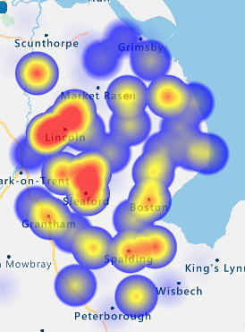
10 Postcode Areas accounted for 54% of the total participant base, with LN6 alone, providing 272 participants, the highest volume from
any single postcode.
Top 10 Postcodes by participant volume | Number of participants
LN6 | 272
LN4 | 215
NG34 | 200
LN2 | 168
DN21 | 162
LN1 | 154
PE12 | 154
LN5 | 148
PE11 | 147
LN11 | 138

Slide 99
Exactly half of the sample in 2020 is retired, with 41% working full or part time.
Which of the options below best describes your employment status?
Base: Working Full Time (n=3,442), Working Part Time (n=1,179), Volunteering (n=207), Intern, Trainee or Apprentice (n=20), Carer (n=142), Home-maker (n=314), Student (n=171), Unemployed (n=201), Retired (n=4,247), Sample Size = 9,923

Slide 100
A slightly lower proportion (-3% cf 2019) of participants in households where a Skilled (C2) and Semi Skilled Manual (D) worker is the chief income earner completed the survey in 2020-21.
Please select the description below which best matches the occupation of the chief income
earner in your household, or their occupation prior to retirement.
Socio Economic Group (SEG)

Slide 101
78% of the 2020 sample are categorised as falling within the ABC1 socio-economic groupings (+4% on 2019) versus around 60% in the resident population of Lincolnshire.
Please select the description below which best matches the occupation of the chief income earner in your household, or their occupation prior to retirement:
NB The minimum target sample size for the C2DE
socio-economic grouping overall was achieved in 2020-21.
Base: ABC1 (n=9,515), C2DE (n=3,166), Student (n=147), Sample Size = 12,828

Slide 102
Key Metrics Dashboard

Slide 103
Key Metrics Dashboard
Metric | 2017 | 2018-19 | 2019-20 | 2020-21 | Year-on-Year Variance
Participants fully completing the survey | 2,906 | 3,449 | 3,302 | 3,243 | -59
Survey completion rate | 73% | 74% | 76% | 79% | +3%
Most widespread & deepest worry | ‘Burglary from the home’ 23% Very worried | ‘Burglary from the home’ 23% Very worried | ‘Burglary from the home’ 21% Very worried | ‘Being a victim of online or cyber crime’ 18% Very worried | -3%
Most widespread experience of crime, either personally or member of household | ‘Been threatened in any way’ 25% | ‘Been threatened in any way’ 21% | ‘Been threatened in any way’ 18% | ‘Been threatened in any way/online crime/telephone fraud’ 13% | -5%
Biggest increase in experience of crime by category | ‘Been subject to online crime’ 15% | ‘Been subject to online crime’ 16% | No increases YOY | No increases YOY | n/a
Views on funding level for Lincolnshire Police | ‘Inadequate’ or ‘Restrictive’ 82% | ‘Should be increased’ 83% | ‘Increased slightly’ OR ‘Increased Further’ 95% | ‘Increased’ 89% | Wording and options changed
% of participants selecting highest incremental increase (+20%) in weekly Police Precept for their Council Tax Band | 35% | 39% | 42% | 35% | -7%
Prompted awareness level of Marc Jones as the current PCC | 59% | 62% | 67% | 70% | +3%

Slide 104
Summary findings and recommendations

Slide 105
Funding for the Police and budgets
Very nearly nine of ten participants (89%) believe that the funding for Lincolnshire Police should be increased, with just 1% believing that a reduction would be appropriate.
At 92% in favour, residents of Boston Borough are the most widely supportive of a funding increase with residents of Lincoln City the least likely to endorse this, but still 86% believe an increase is right.
Residents of the lower bands for Council Tax are no less supportive of an increase in funding for the Police, indeed it is actually residents in bands G and H that are less widely predisposed to an increase. Fully 90% of residents in Band A believe that funding for Lincolnshire Police should be increased.
93% of female participants believe that funding should be increased, compared with 86% for male participants.
Belief in the need for an increase in funding for Lincolnshire Police, barely fluctuates at all across the age bands, falling by just 2% when moving from 65+ participants to the under 35s. Support for an increase is just 1% higher amongst ABC1s at 89% than amongst C2DE participants at 88%.
When invited to allocate Policing budgets residents allocate a tenth of the available budget to ‘Theft & burglary’ and ‘Violence, disorder & anti social behaviour’, with ‘Traffic offences…’, ‘Child abuse’ and ‘Drug abuse..’ each assigned 9%. The greatest decrease in the share of budget
allocated between 2018 and 2020 is to ‘Terrorism & extremism’ (-3.25%).
The ranked incidence of prioritisation for response to 999 emergency calls is very similar to when this question was last asked in 2018. The only difference being ‘…that their property has been broken into’ drops back by -8% and now ranks behind ‘…drug dealing taking place..’.

Slide 106
The Precept
77% of participants are prepared to pay 10%+ more per week, compared with 73% in 2019 (Despite adding an additional low level 2% increase). The percentage not prepared to pay any more has fallen YOY by -7% percentage points.
Perhaps through a combination of the provision of a 2% increase option and the economic impact of Covid-19, there has been a slight reduction, relative to 2019, in the average additional amount that residents are prepared to pay.
Amongst those residents selecting an increase, the average level chosen is 15% across all of the Bands, with the exception of H which averages out at 16%.
When those not prepared to pay any more are included in the calculation, the average % increase across the vast majority of the Council Tax Bands is 13%, falling to 12% in Band A and dropping to 10% in Band H.
One third or more of residents in each Local Authority indicate that they are prepared to pay 20% more per week, with this scale of increase being most widely selected by residents of Lincoln City (40%).
Nearly a quarter (24%) of 16-34 year-olds are resistant to any increase but a rise of 20% is still the option most widely selected (34%) amongst this younger demographic too.
Lack of preparedness to pay any more is higher amongst the C2DE socio-economic group (18%) when compared with ABC1 residents (12%), nonetheless 31% of them are still prepared to pay 20% more.
Nearly a quarter of ‘Fearful’ residents (24%) are not prepared to pay any more. This finding merits further investigation but could be the result of some fearful residents feeling that the police have failed them in some way.

Slide 107
Fear of crime and worry by type of crime
2020 has seen a drift towards ratings of 3 and 4 for ‘Fear of Crime’ and reductions for the high effect indicated by a rating of 5 and over and at 1 for no effect. 2020 has, as we all know, been a challenging and very unusual year. The drift in ratings here may reflect some general unease and low level anxiety but perhaps not about crime and policing per se.
The mean score for ‘Fear of Crime’ in 2020 at 4.04 is more positive than in 2017 and 2018 when this same question was asked.
Residents that are ‘Fearful’ (8-10 Rating) are much more likely to fall within the C2DE socio-economic group and/or live in Boston Borough. Residents who are ‘Not worried’ (1-3 Rating) are more likely to be ABC1 and/or live in North Kesteven. Participants categorised as ‘Anxious’ (4-7 Rating) are more likely to be female and/or live in South Holland.
Residents of North Kesteven are the least likely to be affected by Fear of Crime, whereas 53% of residents in Boston give a rating of 5 or more.
Propensity to be ‘Anxious’ or worse, tends to diminish the higher up the Council Tax Bands you go.
‘…being a victim of identity theft’ and/or ‘…being a victim of online or cyber crime’ attract the mot widespread worry amongst residents with, in each case, 64% of people being ‘very or fairly worried’.
‘Having your home broken into and something stolen’ is very clearly the third most widespread worry, with 60% of people ‘very or fairly worried’ about this.
Over the course of the four years that we have run the Annual Survey, cyber crime and identity theft have overtaken domestic burglary as the most widespread worries.

Slide 108
Local problems and experience of crime
As in previous years ‘Speeding traffic’, is by far the most widely experienced local problem, with 64% of participants regarding this as a ‘very big’ or ‘fairly big’ problem in their local area.
‘…people using or dealing drugs’ is the second most widespread problem, with 35% of participants seeing it as a ‘very or fairly big’ problem in their local area.
The perception that ‘Speeding traffic’ is a ‘very big’ or ‘fairly big’ problem is most widespread in South Holland (74%) followed by residents of Boston Borough (69%).
Residents of Boston Borough are most likely (55%) to regard ‘…people using or dealing drugs’ as a ‘very big’ or ‘fairly big’ problem in their local area, with North Kesteven the least likely to do so (27%).
With the exceptions of ‘…speeding traffic’ and ‘…noisy neighbours’ all other potential problems are perceived to be less of an issue in 2020 – Is this, in part, down to the impact of Covid-19 restrictions?
Exactly a third of participants indicate that either they personally or a member of their household, have experienced at least one form of crime or incident within the last 12 months (-3% .v. 2019)
Experience of crime peaks amongst 16-34 year-olds (38%), the C2DE socio-economic group (37%) and residents of Boston Borough (42%).
‘Non White British’ participants are more likely to indicate experience of each type of crime researched, with the exception of theft from the person and/or of a motor vehicle.
‘Being threatened’ is the event most likely to be experienced more than once (53%), very closely followed by cyber crime/identity theft (51%). Fewer participants experiencing threatening behaviour reference ‘Cyberbullying’ (-4%) whilst slightly more of them reference ‘Threat of violence to the individual concerned’ (+4%). Amongst those experiencing online crime, a higher proportion of them cite a ‘scam or fraud’ (74% +16% .v. 2018) and ‘phishing’ (63% +14% .v. 2018).

Slide 109
Reporting crime
Exactly a quarter of participants had reported a crime or incident to Lincolnshire Police within the last 12 months, representing a reduction of 3% on the equivalent measure in 2018.
Around a third of participants aged 16-49, Students, and/or residents of Boston Borough, Lincoln City or South Holland, indicated that they had reported at least one crime or incident within the last 12 months.
Use of online reporting appears to have increased by 5% percentage points since 2018, representing an increase of a third on two years’ ago. Is the scale of increase in online reporting over the last 24 months reflected in your actual experience with www.lincs.police.uk?
Satisfaction levels are highest for reporting by ‘calling 999’ (56%), followed by ‘to an officer in person’ (51%) whereas dissatisfaction peaks for ‘At a police station in person’ (49%).
The mean scores for satisfaction with reporting have improved since 2018 for ‘called 999’ and ‘called 101’, whilst deteriorating over that same time period for many of the other channels.
Unsurprisingly, calling 999 is the most likely method to report a crime or incident in a future emergency for 58% of participants, significant numbers select ‘to a police officer in person’ (19%) or ‘at a police station’ (12%).
The most likely method to be used to report a non-urgent matter are much more varied. Calling 101 is selected by a fifth of participants, with using online reporting the next most widely selected option (16%).
Participants tend to favour reporting options for non urgent matters that optimise the perceived time (duration and convenience) and effort (spatial/location, etc) involved for them.

Slide 110
Initiatives
93% of participants support the use of ANPR cameras in their area and nearly as many (85%) would support increased use of these devices. 86% of participants back more action on substance misuse.
Awareness of many initiatives or programmes appears to have fallen back slightly in 2020; some of the messaging here may have been overshadowed by Covid-19 campaigns and communications.

Slide 111
Policing the Covid-19 restrictions
Nearly two thirds of participants (64%) believe that the police should have more powers and resources to address violation of official instructions to self-isolate.
Whilst the majority of participants do not offer an opinion, less than a fifth of participants believe that compliance with mask wearing and the rule of six has been policed appropriately, with a higher proportion belieiving the opposite.
Interestingly, both satisfaction and dissatisfaction with the way the rule of six has been policed decreases with age – Perhaps as a result of the younger age cohorts having more experience and/or exposure to hearsay on this and therefore feeling able to offer an opinion?
More male than female participants are likely to offer an opinion on how mask wearing has been policed and a higher proportion of those that do, think that it has not been appropriately policed.
Residents of Boston Borough are much less likely to believe that Lincolnshire Police have handled the national lockdown in a satisfactory way (39% disagree), whereas more than twice as many residents of North Kesteven are satisfied (34%) as disagree (16%).
Over two thirds of the participants who believe police funding should be increased, also believe the police should have more powers and resources to address violation of official instructions to
self-isolate – they support the means, as well as will the ends.
Witnessing non-compliance and concerns regarding the ability to enforce restrictions (both beat officers and resources) collectively account for very nearly 60% of dissatisfaction with the way that the lockdowns have been policed.

Slide 112
Awareness of the role
It would appear that around 85% of participants who are aware of the position of PCC, know that Marc Jones is the current incumbent – on a prompted basis at least.
Fewer than a third of participants (29%) claim to already have been aware of the cost saving arising from the introduction of the PCC role, even when prompted with it.
Prompted awareness of the position of Lincolnshire PCC appears to have increased by +6% since 2017 to 82% in 2020.
Prompted awareness of Marc Jones as the current PCC has increased by +15% since 2017 to 70% in 2020.

Slide 113
Media channel use and preference
Exactly half of the participant base indicated that they use Facebook everyday, with 80% using this social media channel at least occasionally – it dwarfs the usage of the other media channels.
Next Door would appear to be building usage quite quickly with 22% of participants indicating that they use this channel at least on a weekly basis.
60% of female participants use Facebook everyday, compared with 43% of male participants. Males use Twitter, Linkedin and Lincs Alert more widely and more frequently than females do.
Facebook represents the preferred media channel to receive information and news about policing and community safety for 42% of participants, followed by 18% favouring Lincs Alert and
10% Next Door.
Facebook is the most widely preferred media channel for receiving information and news about policing, etc among participants in each age band but this decreases with age, whereas preference for Lincs Alert increases with age.
Female participants more widely preference Facebook and Next Door, whereas male participants more widely preference Twitter and Lincs Alert.

Slide 114
Interest in joining the Panel
636 survey participants (20%) expressed interest in joining the
Lincolnshire’s SAFER TOGETHER Research Panel and provided their contact details in order to be supplied with further information. An increase of +158 in those interested in joining the Panel versus 2019.
The vast majority of participants expressing an interest in joining the Research Panel are aged 50+.
In 2021 we ned to collaborate in identifying subjects for research and sources/affinity partners that will successfully encourage more under 50s to join the Panel.
100+ participants who are resident in: East Lindsey (133), North Kesteven (113) and South Kesteven (100), expressed an interest in joining the Research Panel.
Ways to boost or tap interest amongst residents of Boston Borough should be explored.

Slide 115
Sample profile
The ratio of Males to Females participating at 53%:45% has reverted to the mean from the first two years’ of running the survey, in part because the shorter fieldwork period afforded less time to respond to this.
The proportion of participants over 65 rose significantly to 45% in the 2020 Survey, whereas the proportion of 16-34 year-olds participating fell sharply to 4%.
Greater emphasis will need to be placed on participant recruitment sources that engage the under 50s and the under 35s in particular. The volume of survey completes by under 35s delivered by the major sources: Lincs Alert, Next Door and the Panel are very low indeed.
93% of the participant sample self-categorising as White British continues to mirror what we currently know about the resident population.
The number of participants living in a household that includes at least one child or young person, fell by 6% in 2020, compared with 2019, reflecting the older profile of participants.
No single local authority is over or under-represented by more than 4% percentage points. North Kesteven and West Lindsey are bothover-represented by +4% with Lincoln City under-represented by -3%.
The share of participants in Bands E and F has risen by +2% percentage points in 2020 (.v. 2019), with a fall in share of -2% percentage points for Residents of Band A.
Exactly half of the sample in 2020 is retired, with 41% working full or part time.
78% of the 2020 sample are categorised as falling within the ABC1 socio-economic groupings (+4% on 2019) versus around 60% in the resident population of Lincolnshire. NB The minimum target sample size for the C2DE socio-economic grouping overall was achieved in 2020-21.

Slide 116
Sample profile
In 2020-21 3,243 fully completed surveys were achieved, just 59 fewer than in 2019-20, even though there were 10 days’ fewer in field.
The Confidence Interval for the sample as whole, at the County Level is ± 1.72 in 2020-21
(versus ± 1.70 in 2019-20).
All target sample levels were met and exceeded for each segment, with the exception of
16-34 year-olds and residents of Boston Borough.
The ratio of Males to Females participating, at 53:45, has reverted to the mean from the first two years’ of running the survey, in part because the shorter fieldwork period afforded less time to respond to this.
The proportion of participants over 65 rose significantly to 45% in the 2020 Survey, whereas the proportion of 16-34 year-olds participating fell sharply to 4%. Greater emphasis will need to be placed on participant recruitment sources that engage the under 50s and the under 35s in particular.
The number of participants living in a household that includes at least one child or young person, fell by 6% in 2020, compared with 2019, reflecting the older profile of participants.
No single local authority is over or under-represented by more than 4% percentage points.
The share of participants in Bands E and F has risen by +2% percentage points in 2020 (.v. 2019), with a fall in share of -2% percentage points for Residents of Band A.
Exactly half of the sample in 2020 is retired, with 41% working full or part time.
78% of the 2020 sample are categorised as falling within the ABC1 socio-economic groupings (+4% on 2019) versus around 60% in the resident population of Lincolnshire. NB The minimum target sample size for the C2DE socio-economic grouping overall was achieved in 2020-21.

Slide 117
Next steps

Slide 118
General
Habit5 to provide all verbatim answers to the free text questions included in the survey
All to agree any additional analysis: cross tabulations or weighted results
All to agree what, when and how any public communication of the survey results should be implemented

Slide 119
Community Panel Actions
February 2021 - Email communication to join deployed to the 636 participants expressing interest in joining the Panel
Including:-
Thanks from Marc Jones
2020-21 Survey results highlights, responses and any intended initiatives
Potential future research studies or themes for further investigation
Possible themes or subject areas:
Research specifically with residents categorised as ‘Fearful’, to investigate in more depth and detail, the drivers of their fears
Ways to increase satisfaction with online reporting and so expand uptake and repeat use
Development of Resident Personas that draw upon insights from the Annual Survey data

Slide 120
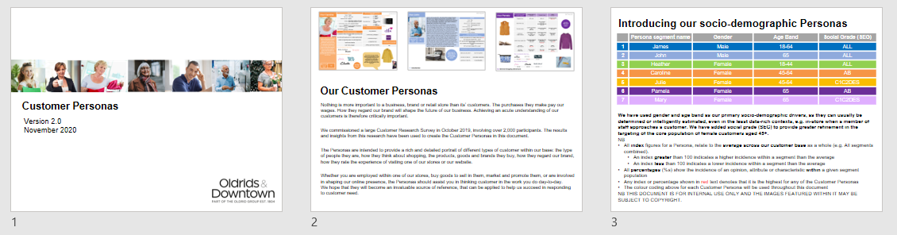
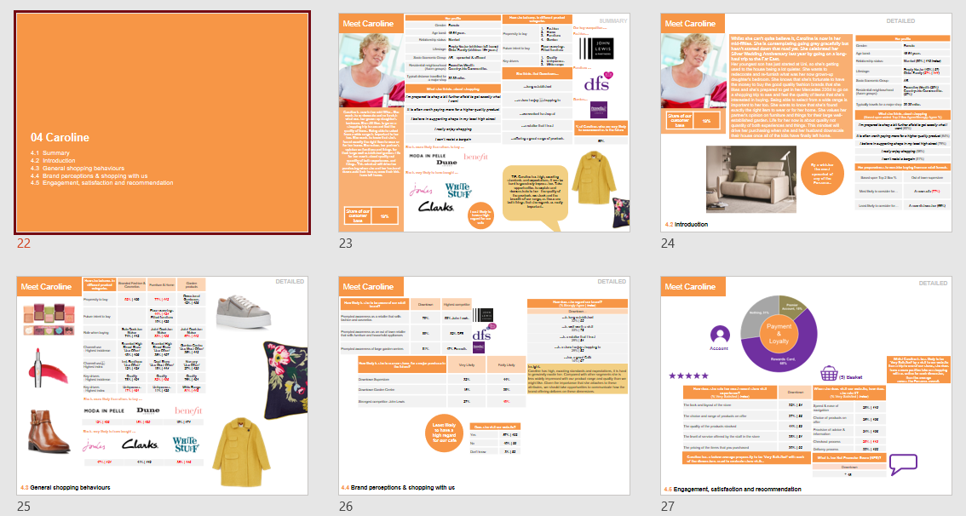
Resident Segment Personas
Definition, sizing, profiling and pen portraits
We are experienced in creating rich and detailed attitude and/or behaviour-driven Segment Personas, evidence-based from our own robust quantitative and qualitative research data.
We distil the profiles that emerge from analysis for each segment, writing up and illustrating their motivations, attitudes, behaviours and intentions.
The Annual Survey provides a wealth of attitudinal, behavioural and
socio-demographic data to support the development of Personas.

Slide 121
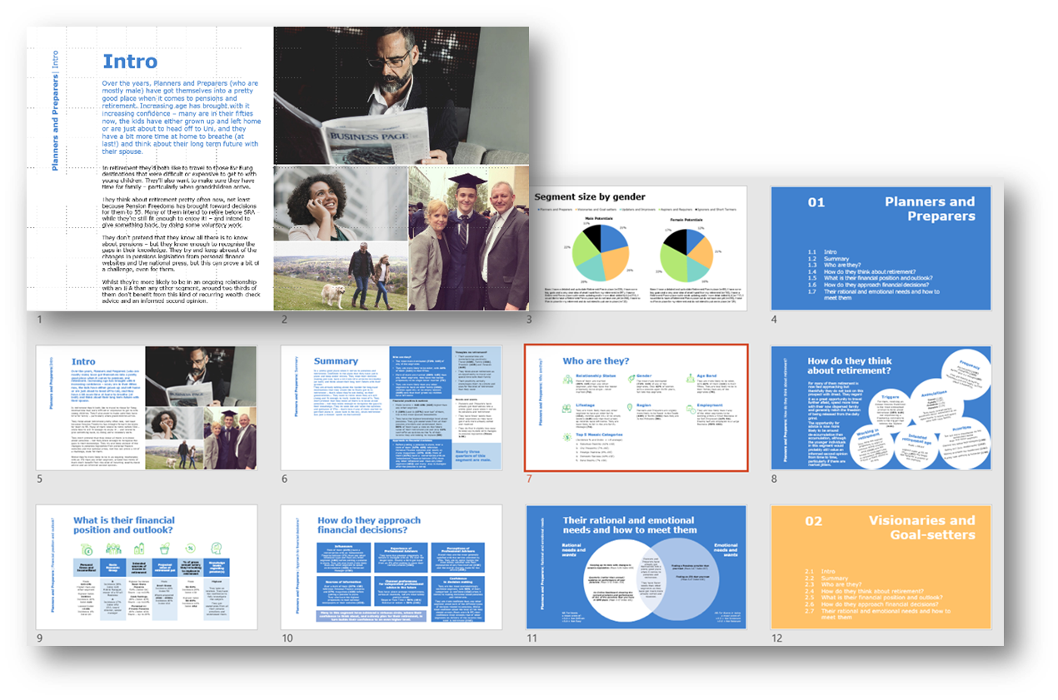
Resident Segment Personas
Deciding upon the most valuable dimensions
The first step is to decide which dimension(s) to use to drive the segmentation of the Resident population.
The dimension used could be:
Attitudinal e.g. ‘Fear of Crime’ – ‘Fearful’, ‘Anxious’, ‘Not worried’
Experiential e.g. Victims of different types of crime
Behavioural e.g. Preferred media channel or reporting method
Demographic e.g. Age bands
or Local Authority.

Slide 122

Resident Segment Personas
Why develop and use them?
Resident Segment Personas that draw upon the data and insights that you have at your disposal from the Annual Survey could:
Bring research insights to life, embedding them in your
day-to-day work
Practically inform the origination of communication or contact strategies
Aid the targeting of existing or new initiatives, campaigns or programmes
Enhance the briefing and development of strategies, communications and messaging
Enrich the process of user experience design
If having access to this resource is of interest, we would be happy to provide a fully detailed and costed proposal to develop Resident Segment Personas.

Slide 123

Thank you.
David Jones
Managing Director
T. +44 (0) 1522 519388
M. +44 (0) 7702 596260
david.jones@habit5.co.uk
www.habit5.co.uk
Main office:
Habit5
Unit E29
Enterprise Building
Ropewalk
Lincoln
LN6 7DQ

