Slide 1
Lincolnshire Crime & Policing Survey
Prepared for: Marc Jones, Police & Crime Commissioner for Lincolnshire 12/01/2018 v1.0
© Habit5 2018

Slide 2
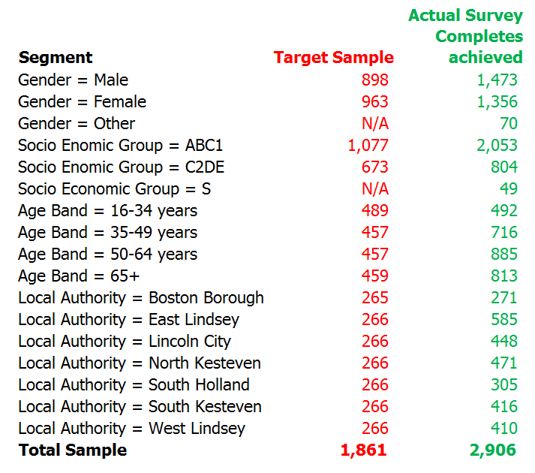
Who we needed to understand Permanent residents of Lincolnshire
The ONS mid-year 2017 population estimate for Lincolnshire of 599,746 Adults aged 18+ was used to calculate the target sample required in order to achieve a Confidence Interval of ± 6 for each of the demographic segments on the right at the 95% Confidence Level.
The Confidence Interval for the sample as whole, at the County Level is ± 1.81.
Actual completed surveys achieved are shown beside the target. All target sample levels were met and exceeded for each segment.
NB No target sample volumes were originally set for participants categorising their gender as ‘Other’ or Socio Economic Group = S for Full Time Students.
Confidence Level & Confidence Interval # The total sample size is based on a 95% Confidence Level and a minimum Confidence Interval by segment of ± 6.
This is to ensure the statistical significance of the results for each segment. It means that had we surveyed everyone in our population the answer to a given question would fall within 6% of our research result (in either direction) on 95 occasions out of 100.

Slide 3
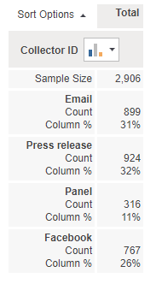
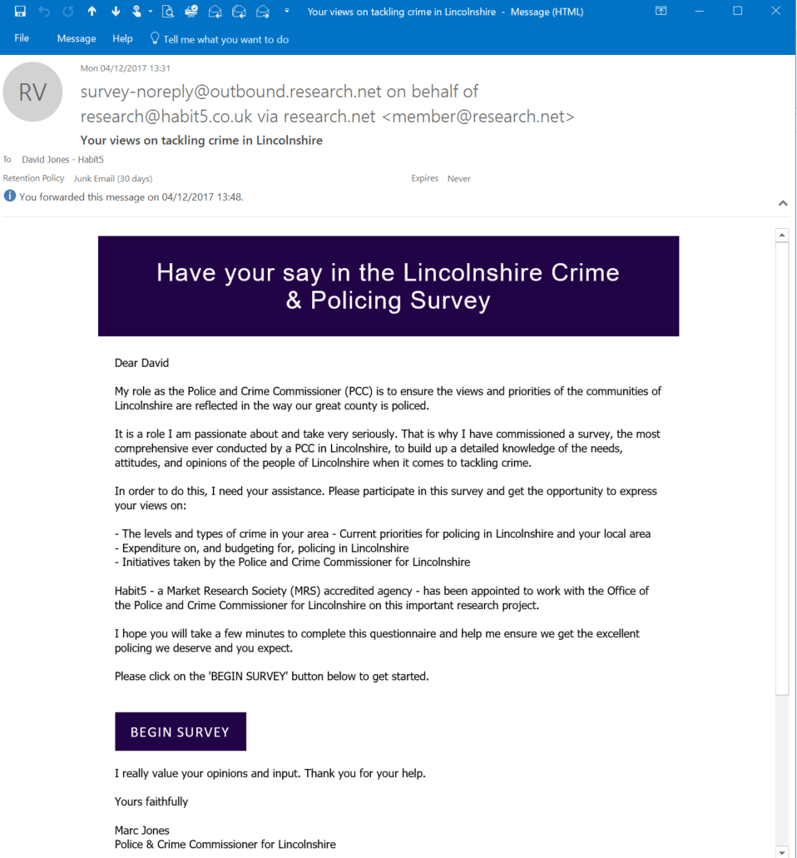
Recruiting participants Several different media channels were deployed
In order to maximise and diversify public engagement with the survey, multiple different media channels (or collectors) were used to promote it.
Sample composition by recruitment source.
Outbound Email Invitation | Facebook Promotion | PR from Press Release | Consumer Panel
An HTML email featuring a link to the survey was mailed to known Lincolnshire residents. | A promotional post on Facebook featuring a link to the survey was deployed & targeted to reach specific demographic segments. | Several press releases were issued referencing the survey. The story was picked up and featured on multiple news websites & offline publications. | Research Now access panel participants were recruited again in targeted segments.

Slide 4
The geographic distribution of the survey sample very closely reflects the resident population of Lincolnshire.
Which local authority area are you permanently resident in?
Lincoln City and West Lindsey are very slightly over-represented.
South Holland and more markedly South Kesteven under-represented.
Base: Boston Borough (n=271), East Lindsey (n=585), Lincoln City (n=448), North Kesteven (n=471), South Holland (n=305), South Kesteven (n=416), West Lindsey (n=410)

Slide 5
More than two thirds (68%) of the sample have been resident in the same local area for at least 10 years.
How long have you lived in this area? (By this area, we mean within about a 15 minute walk from your current address.)
Base: <12m (n=87), >12m <2 yrs (n=100), >2 yrs <3 yrs (n=128), >3yrs <5yrs (n=225), >5yrs <10yrs (n=400), >10yrs <20yrs (n=717), 20yrs + (n=1,249)

Slide 6
Survey findings

Slide 7
How much is YOUR OWN quality of life affected by FEAR OF CRIME on a scale from 1 to 10, where 1 is no effect and 10 is a total effect on your quality of life?
Base: 1 (n=321), 2 (n=547), 3 (n=530), 4 (n=292), 5 (n=388), 6 (n=249), 7 (n=229), 8 (n=223), 9 (n=61), 10 (n=66)

Slide 8
The mean rating scores by Local Authority provide an early indication of the increased impact on quality of life in Boston Borough & to a lesser extent South Holland.
How much is YOUR OWN quality of life affected by FEAR OF CRIME on a scale from 1 to 10, where 1 is no effect and 10 is a total effect on your quality of life? Mean scores
The more positive perceptions of residents of North Kesteven are also clearly evidenced here.
Base: Boston Borough (n=271), East Lindsey (n=585), Lincoln City (n=448), North Kesteven (n=471), South Holland (n=305), South Kesteven (n=416), West Lindsey (n=410)

Slide 9
To simplify and aid analysis we grouped the ratings for total effect on quality of life into four segments.
How much is YOUR OWN quality of life affected by FEAR OF CRIME on a scale from 1 to 10, where 1 is no effect and 10 is a total effect on your quality of life? (Grouped)
12% of the sample can be regarded as ‘Very Fearful’ of crime, with this having a significant impact on their quality of life.
Base: Little or No Affect (n=868), Minor Anxiety (n=822), Anxious (n=866), Very Fearful (n=350)

Slide 10
People in Boston Borough are the most widely impacted by heightened fear of crime and those in North Kesteven the most narrowly impacted.
How much is YOUR OWN quality of life affected by FEAR OF CRIME on a scale from 1 to 10, where 1 is no effect and 10 is a total effect on your quality of life? (Grouped and By Local Authority)
58% of participants in Boston Borough can be classified as ‘Anxious’ or ‘Very Fearful’ compared with just 30% in North Kesteven.
Base: Boston Borough (n=271), East Lindsey (n=585), Lincoln City (n=448), North Kesteven (n=471), South Holland (n=305), South Kesteven (n=416), West Lindsey (n=410)

Slide 11
Burglary from the home is both the most widespread and deep-seated worry, whilst being a victim of cyber crime or identity theft also causes widespread worry.
Most of us worry at some time or other about being the victim of a crime. Please indicate how worried you are or aren't about each of the following...
Base: ...having your home broken into and something stolen? (n=2,906), ...being mugged or robbed? (n=2,906), ...having your car stolen? (n=2,906), ...having things stolen from your car? (n=2,906), ...being raped? (n=2,906), ...being physically attacked by strangers? (n=2,906), ...being a victim of online or cyber crime? (n=2,906), ...being a victim of identity theft? (n=2,906)

Slide 12
78% of people believe that crime has gone up nationally. 73% believe this is true for Lincolnshire and 56% feel the same about their local area.
What do you think has happened to crime, over the past few years...
Base: ...across the country as a whole? (n=2,906), ...in the county of Lincolnshire? (n=2,906), ...in your immediate local area? (n=2,906)

Slide 13
Residents of Boston Borough are the most likely (75%) to believe that crime has gone up locally, followed by South Holland (68%), with North Kesteven the least likely (41%).
What do you think has happened to crime, over the past few years... (By Local Authority for ‘…in your immediate local area’ only)
If perceptions in a Local Authority do NOT reflect reality then more may need to be done in communications terms to change these beliefs.
Base: Boston Borough (n=271), East Lindsey (n=585), Lincoln City (n=448), North Kesteven (n=471), South Holland (n=305), South Kesteven (n=416), West Lindsey (n=410)

Slide 14
‘Speeding traffic’ is seen as a problem by more people (65%) than any other offence and more people regard this as ‘A very big problem’ in their local area.
Thinking about your immediate LOCAL AREA, how much of a problem, if at all, are each of the following...
‘People using or dealing drugs’ and ‘burglary or theft from private property’ are the next most widely perceived problems (45%).
But these county wide results mask major differences at the Local Authority level.
Base: ...noisy neighbours or loud parties? (n=2,906), ...antisocial street drinking? (n=2,906), ...vandalism, graffiti and other deliberate damage to property or vehicles? (n=2,906), ....burglary and theft from private property? (n=2,906), ...people using or dealing drugs? (n=2,906), ...people being drunk or rowdy in public places? (n=2,906), ...physical assault or other violent behaviour? (n=2,906), ...speeding traffic? (n=2,906)

Slide 15
‘Antisocial street drinking’ is a big problem in the mind of residents of Boston Borough and to a lesser extent South Holland.
Thinking about your immediate LOCAL AREA, how much of a problem, if at all, are each of the following... (...antisocial street drinking? By Local Authority)
Is Lincoln City, a large urban environment getting anything right here that Boston Borough could learn from?
Base: Boston Borough (n=271), East Lindsey (n=585), Lincoln City (n=448), North Kesteven (n=471), South Holland (n=305), South Kesteven (n=416), West Lindsey (n=410)

Slide 16
‘Noisy neighbours or loud parties’ are more widely perceived as a big problem in the more urban areas of Boston Borough and Lincoln City.
Thinking about your immediate LOCAL AREA, how much of a problem, if at all, are each of the following…(…noisy neighbours or loud parties? By Local Authority)
Base: Boston Borough (n=271), East Lindsey (n=585), Lincoln City (n=448), North Kesteven (n=471), South Holland (n=305), South Kesteven (n=416), West Lindsey (n=410)

Slide 17
‘Vandalism, etc’ in their local area is perceived as a big problem by over 40% of people in Boston Borough, Lincoln City and South Holland.
Thinking about your immediate LOCAL AREA, how much of a problem, if at all, are each of the following... (...vandalism, graffiti and other deliberate damage to property or vehicles? By Local Authority)
Base: Boston Borough (n=271), East Lindsey (n=585), Lincoln City (n=448), North Kesteven (n=471), South Holland (n=305), South Kesteven (n=416), West Lindsey (n=410)

Slide 18
Two thirds of residents in Boston Borough see drug use and dealing in their local area as a big problem.
Thinking about your immediate LOCAL AREA, how much of a problem, if at all, are each of the following... (...people using or dealing drugs? By Local Authority)
Very nearly the same proportion of residents in South Holland (54%) perceive drug use and dealing as a big problem, as do residents of Lincoln City (55%). Is this what would have been anticipated?
Base: Boston Borough (n=271), East Lindsey (n=585), Lincoln City (n=448), North Kesteven (n=471), South Holland (n=305), South Kesteven (n=416), West Lindsey (n=410)

Slide 19
Again, Boston Borough stands out as having a perceived big problem (65%) with drunkenness and rowdy behaviour in public places.
Thinking about your immediate LOCAL AREA, how much of a problem, if at all, are each of the following... (...people being drunk or rowdy in public places? By Local Authority)
Could Boston learn anything from say Gainsborough (within West Lindsey) or are the dynamics just too different to support this?
Base: Boston Borough (n=271), East Lindsey (n=585), Lincoln City (n=448), North Kesteven (n=471), South Holland (n=305), South Kesteven (n=416), West Lindsey (n=410)

Slide 20
27% more residents of Boston Borough perceive physical assault to be a big problem in their local area than any other Local Authority.
Thinking about your immediate LOCAL AREA, how much of a problem, if at all, are each of the following... (...physical assault or other violent behaviour? By Local Authority)
Given the very widespread perceived problems in Boston Borough should any further actions or steps be taken to address the challenges there?
Base: Boston Borough (n=271), East Lindsey (n=585), Lincoln City (n=448), North Kesteven (n=471), South Holland (n=305), South Kesteven (n=416), West Lindsey (n=410)

Slide 21
‘Speeding traffic’ is regarded as a big problem by at least 57% of residents in any Local Authority, peaking at 74% in South Holland.
Thinking about your immediate LOCAL AREA, how much of a problem, if at all, are each of the following... (...speeding traffic? By Local Authority)
A new county wide initiative here should receive widespread support, so long as it is not regarded as a revenue raising scheme.
Base: Boston Borough (n=271), East Lindsey (n=585), Lincoln City (n=448), North Kesteven (n=471), South Holland (n=305), South Kesteven (n=416), West Lindsey (n=410)

Slide 22
A quarter of participants indicate that they, or a member of their household, has been threatened in some way. A higher incidence level than for any other form of offence.
During the last 12 months specifically, have you PERSONALLY or has anyone else in your household...
More than 1 in 7 people live in a household that has been subject to online crime, cyber crime or identity theft.
Base: ...had a car, van, motorcycle, or other motor vehicle stolen? (n=2,906), ...had anything stolen, off or from inside, a vehicle? (n=2,906), ...had anything stolen from your home? (n=2,906), ...had any personal possessions stolen whilst in a public place? (n=2,906), ...been physically attacked by another person? (n=2,906), ...been threatened in any way? (n=2,906), ...been subject to online crime, cyber crime and/or identity theft? (n=2,906)

Slide 23
The divergence in incidence by Local Authority of experiencing different crimes, is well-evidenced by comparing Boston Borough & North Kesteven.
During the last 12 months specifically, have you PERSONALLY or has anyone else in your household...
Base: Variable

Slide 24
Experience of vehicle theft is universally at 3% or lower.
During the last 12 months specifically, have you PERSONALLY or has anyone else in your household... (...had a car, van, motorcycle, or other motor vehicle stolen? By Local Authority)
Base: Boston Borough (n=271), East Lindsey (n=585), Lincoln City (n=448), North Kesteven (n=471), South Holland (n=305), South Kesteven (n=416), West Lindsey (n=410)

Slide 25
Theft from a vehicle peaks at 11% in Lincoln City, falling to a low of 5% in North Kesteven.
During the last 12 months specifically, have you PERSONALLY or has anyone else in your household...(...had anything stolen, off or from inside, a vehicle? By Local Authority)
Base: Boston Borough (n=271), East Lindsey (n=585), Lincoln City (n=448), North Kesteven (n=471), South Holland (n=305), South Kesteven (n=416), West Lindsey (n=410)

Slide 26
Experience of theft from their property is five times higher in Boston Borough than in North Kesteven.
During the last 12 months specifically, have you PERSONALLY or has anyone else in your household... (...had anything stolen from your home? By Local Authority)
Base: Boston Borough (n=271), East Lindsey (n=585), Lincoln City (n=448), North Kesteven (n=471), South Holland (n=305), South Kesteven (n=416), West Lindsey (n=410)

Slide 27
1 in 10 residents of Lincoln City live in a household where someone has experienced theft of personal possessions in a public place in the last 12 months.
During the last 12 months specifically, have you PERSONALLY or has anyone else in your household... (...had any personal possessions stolen whilst in a public place? By Local Authority)
Base: Boston Borough (n=271), East Lindsey (n=585), Lincoln City (n=448), North Kesteven (n=471), South Holland (n=305), South Kesteven (n=416), West Lindsey (n=410)

Slide 28
Experience of physical attack is at twice the level amongst households in Lincoln City than in North Kesteven or West Lindsey.
During the last 12 months specifically, have you PERSONALLY or has anyone else in your household... (...been physically attacked by another person? By Local Authority)
Base: Boston Borough (n=271), East Lindsey (n=585), Lincoln City (n=448), North Kesteven (n=471), South Holland (n=305), South Kesteven (n=416), West Lindsey (n=410)

Slide 29
Perceptions of the scale of a problem can be inflated beyond the reality of recent experience, as the data for Boston Borough & Lincoln City on physical assault shows.
Thinking about your immediate LOCAL AREA, how much of a problem, if at all, are each of the following... ...physical assault or other violent behaviour? By Local Authority
During the last 12 months specifically, have you PERSONALLY or has anyone else in your household... ...been physically attacked by another person? By Local Authority
Local Perceptions
Actual Experience
Perceptions of how successful or unsuccessful the police may be in combating this type of criminal offence will play into this to.
Base: Boston Borough (n=271), Lincoln City (n=448

Slide 30
The geographic incidence of online crime is very different to every other form of crime, peaking in South Kesteven at 19%.
During the last 12 months specifically, have you PERSONALLY or has anyone else in your household... (...been subject to online crime, cyber crime and/or identity theft? By Local Authority)
Experience of online crime is very much a county wide issue and cuts across all demographic groups with no particular profile emerging.
Base: Boston Borough (n=271), East Lindsey (n=585), Lincoln City (n=448), North Kesteven (n=471), South Holland (n=305), South Kesteven (n=416), West Lindsey (n=410)

Slide 31
Whilst marginally more people perceive that the police are successful in combating vehicle-related theft in their local area, the proportion who don’t know rises too.
How successful do you PERSONALLY believe the police are, in combating the crimes listed below, for each of the different geographies shown. (Please use the dropdown answer options to indicate your answer in each case.)
Could any more actions be taken locally to explain measures to combat different forms of crime and/or successes in solving crimes in the local area/authority.
Base: Theft of, or from, motor vehicles - Across the UK as a whole (n=2,831), Theft of, or from, motor vehicles - In the county of Lincolnshire (n=2,633), Theft of, or from, motor vehicles - In your local area (n=2,553)

Slide 32
Residents of Lincoln City & North Kesteven are more likely (26%) to see the police as successful in combating vehicle-related theft than residents of Boston Borough (19%).
How successful do you PERSONALLY believe the police are, in combating the crimes listed below, for each of the different geographies shown. (Please use the dropdown answer options to indicate your answer in each case.) Theft of, or from, motor vehicles - In your local area by Local Authority.
Base: Boston Borough (n=241), East Lindsey (n=523), Lincoln City (n=366), North Kesteven (n=414), South Holland (n=273), South Kesteven (n=368), West Lindsey (n=368)

Slide 33
Perceived police success in combating property-related theft is again marginally higher locally than nationally but again don’t knows increase locally.
How successful do you PERSONALLY believe the police are, in combating the crimes listed below, for each of the different geographies shown. (Please use the dropdown answer options to indicate your answer in each case.)
Base: Theft from property (e.g. burglary) - Across the UK as a whole (n=2,830), Theft from property (e.g. burglary) - In the county of Lincolnshire (n=2,637), Theft from property (e.g. burglary) - In your local area (n=2,558)

Slide 34
Residents of North Kesteven are the most likely (32%) to regard the police as successful in combating property related theft in their local area, Boston the least (18%).
How successful do you PERSONALLY believe the police are, in combating the crimes listed below, for each of the different geographies shown. (Please use the dropdown answer options to indicate your answer in each case.) Theft from property (e.g. burglary) - In your local area by Local Authority.
Base: Boston Borough (n=241), East Lindsey (n=527), Lincoln City (n=362), North Kesteven (n=417), South Holland (n=274), South Kesteven (n=367), West Lindsey (n=370)

Slide 35
The same pattern as for other crimes is true for theft of personal possessions, marginally more likely to perceive success locally but a quarter don’t know.
How successful do you PERSONALLY believe the police are, in combating the crimes listed below, for each of the different geographies shown. (Please use the dropdown answer options to indicate your answer in each case.)
Base: Theft of personal possessions (e.g. robbery or pick-pocketing) - Across the UK as a whole (n=2,831), Theft of personal possessions (e.g. robbery or pick-pocketing) - In the county of Lincolnshire (n=2,635), Theft of personal possessions (e.g. robbery or pick-pocketing) - In your local area (n=2,555)

Slide 36
Regarding theft of personal possessions, once again residents of North Kesteven are the most widely positive and residents of Boston Borough the most negative.
How successful do you PERSONALLY believe the police are, in combating the crimes listed below, for each of the different geographies shown. (Please use the dropdown answer options to indicate your answer in each case.) Theft of personal possessions (e.g. robbery or pick-pocketing) - In your local area by Local Authority
Base: Boston Borough (n=241), East Lindsey (n=525), Lincoln City (n=362), North Kesteven (n=416), South Holland (n=273), South Kesteven (n=368), West Lindsey (n=370)

Slide 37
Universally, considerably more people are prepared to believe that the police are successful in combating physical attacks than the other forms of crime researched in this study.
How successful do you PERSONALLY believe the police are, in combating the crimes listed below, for each of the different geographies shown. (Please use the dropdown answer options to indicate your answer in each case.)
Base: Physical attacks (e.g. assault or rape) - Across the UK as a whole (n=2,829), Physical attacks (e.g. assault or rape) - In the county of Lincolnshire (n=2,637), Physical attacks (e.g. assault or rape) - In your local area (n=2,552)

Slide 38
Residents in South Holland are the most widely prepared to see the police as successful in combating physical attacks (49%) with Boston Borough the most negative.
How successful do you PERSONALLY believe the police are, in combating the crimes listed below, for each of the different geographies shown. (Please use the dropdown answer options to indicate your answer in each case.) Physical attacks (e.g. assault or rape) - In your local area by Local Authority.
Have there been any initiatives that might explain this strong performance by South Holland, particularly as physical assault is regarded as a big problem by a higher than average number of residents in this authority?
Base: Boston Borough (n=241), East Lindsey (n=526), Lincoln City (n=363), North Kesteven (n=414), South Holland (n=272), South Kesteven (n=367), West Lindsey (n=369)

Slide 39
Five categories of offence get selected by over half of Lincolnshire residents as worthy of greater focus and policing resource.
Thinking about the county of LINCOLNSHIRE specifically, please indicate from the list below, the FIVE categories that you believe could benefit most from greater focus and policing resource.
‘Neighbourhood policing’ is closely followed by: ‘Drug abuse and dealing’, ‘Violence, disorder & antisocial behaviour’, ‘Theft & burglary’ and ‘Traffic offences & road safety’ as the five selected top prioriities.
Base: Violence, disorder & antisocial behaviour (n=1,760), Domestic abuse (n=704), Hate crime (n=382), Firearms offences (n=133), Serious organised crime (n=545), Neighbourhood policing (n=1,858), Drug abuse and dealing (n=1,840), Fraud & money laundering (n=338), Terrorism & extremism (n=405), Child abuse (n=895), Rape or other sexual crimes (n=693), Human traffiking & missing persons (n=475), Traffic offences & road safety (n=1,535), Theft & burglary (n=1,776), Rural crime (e.g. hare coursing, poaching, etc) (n=1,191)

Slide 40
The comparative volumes of additional police officers allocated closely reflects the prioritisation for focus.
Please imagine that you have an additional TEN police officers to deploy in LINCOLNSHIRE, across the five priorities that you have just selected in the previous question. Please select an answer to indicate the number of these police officers that you would wish to deploy against the priorities shown. (Please deploy TEN in total) Total numbers of officers allocated.
Base: Violence, disorder & antisocial behaviour (n=1,716), Domestic abuse (n=695), Hate crime (n=373), Firearms offences (n=127), Serious organised crime (n=524), Neighbourhood policing (n=1,833), Drug abuse and dealing (n=1,791), Fraud & money laundering (n=315), Terrorism & extremism (n=386), Child abuse (n=880), Rape or other sexual crimes (n=680), Human traffiking & missing persons (n=458), Traffic offences & road safety (n=1,504), Theft & burglary (n=1,733), Rural crime (e.g. hare coursing, poaching, etc) (n=1,171)

Slide 41
‘Hate crime’ experiences the highest reduction in police officers, people are least prepared to reduce officer numbers associated with ‘Theft & burglary’ and ‘Child abuse’.
Please now take a moment to imagine that you have to REDUCE by TEN the number of police officers across LINCOLNSHIRE. Please select an answer to indicate the number of police officers that you would choose to remove against the categories shown. (Please remove TEN in total) Total volume of officers removed
Base: Violence, disorder & antisocial behaviour (n=916), Domestic abuse (n=1,691), Hate crime (n=2,238), Firearms offences (n=2,300), Serious organised crime (n=1,873), Neighbourhood policing (n=812), Drug abuse and dealing (n=837), Fraud & money laundering (n=2,219), Terrorism & extremism (n=1,984), Child abuse (n=1,330), Rape or other sexual crimes (n=1,523), Human traffiking & missing persons (n=2,000), Traffic offences & road safety (n=1,211), Theft & burglary (n=865), Rural crime (e.g. hare coursing, poaching, etc) (n=1,549)

Slide 42
82% of Lincolnshire residents regard the current funding level for the Lincolnshire police force as ‘restrictive’ or ‘inadequate’.
Which of the descriptions below most closely matches your opinion of the current funding level for the LINCOLNSHIRE Police force?
Fewer than 1 in 5 Lincolnshire residents (18%) regard the current funding level for the Lincolnshire police force as ‘Fair’ or better.
Base: Generous (n=36), Healthy (n=63), Fair (n=435), Restrictive (n=955), Inadequate (n=1,417)

Slide 43
Residents of Boston Borough are more likely (87%) to regard current police funding as ‘Restrictive’ or ‘Inadequate’.
Which of the descriptions below most closely matches your opinion of the current funding level for the LINCOLNSHIRE Police force?
Base: Generous (n=36), Healthy (n=63), Fair (n=435), Restrictive (n=955), Inadequate (n=1,417)

Slide 44
‘Neighbourhood watch/Lincs Alert’ is regarded as the third most important source of information on crime and policing in Lincolnshire specifically.
Please rate the importance to you PERSONALLY of each of the potential sources of information on crime and policing in LINCOLNSHIRE specifically. (On a scale of 1-5 where 1=Not important at all and 5= Very Important)
Across the sample as a whole Twitter and Facebook are regarded as net unimportant (less than 3.0).
50+ year olds regard ‘TV News’ as more important than ‘Personal experience’.
Base: Personal experience (n=2,861), Word of mouth (n=2,882), TV news (n=2,871), Radio news (n=2,885), Online news websites (n=2,865), Twitter (n=2,852), Facebook (n=2,870), Printed media (n=2,879), Neighbourhood watch / Lincs Alert (n=2,880)

Slide 45
‘Facebook’ is much more important to 16-34 year olds but ‘Twitter’ remains net unimportant to them.
Please rate the importance to you PERSONALLY of each of the potential sources of information on crime and policing in LINCOLNSHIRE specifically. (On a scale of 1-5 where 1=Not important at all and 5= Very Important) 16-34 year olds ONLY
Base: Personal experience (n=488), Word of mouth (n=490), TV news (n=488), Radio news (n=489), Online news websites (n=486), Twitter (n=490), Facebook (n=491), Printed media (n=491), Neighbourhood watch / Lincs Alert (n=490)

Slide 46
‘Neighbourhood watch/Lincs Alert’ represents the second most trusted source of information after ‘Personal experience’.
Please indicate the extent to which you PERSONALLY trust each of the potential sources of information on crime and policing in LINCOLNSHIRE specifically. . (On a scale of 1-5 where 1=Not trusted at all and 5= Very Trustworthy)
‘Neighbourhood watch/Lincs Alert’ is the second most trusted source across ALL age bands.
‘Twitter’ and ‘Facebook’ are universally distrusted by ALL age bands.
‘TV News’ is trusted more than ‘Radio News’ by under 35s.
Base: Word of mouth (n=2,893), Personal experience (n=2,877), TV news (n=2,886), Radio news (n=2,879), Online news websites (n=2,876), Twitter (n=2,860), Facebook (n=2,879), Printed media (n=2,886), Neighbourhood watch / Lincs Alert (n=2,882)

Slide 47
52% of the C2DE segment rate the affect of the fear of crime on their own quality of life at 5+, compared with just 42% of the ABC1 segment.
How much is YOUR OWN quality of life affected by FEAR OF CRIME on a scale from 1 to 10, where 1 is no effect and 10 is a total effect on your quality of life? (By Socio Economic Group SEG)
Base: 1 (n=321), 2 (n=547), 3 (n=530), 4 (n=292), 5 (n=388), 6 (n=249), 7 (n=229), 8 (n=223), 9 (n=61), 10 (n=66)

Slide 48
Experience of every type of criminal offence is higher amongst ‘Not White British’ residents.
During the last 12 months specifically, have you PERSONALLY or has anyone else in your household...

Slide 49
Five categories of offence get selected by over half of Lincolnshire residents as worthy of greater focus and policing resource.
Thinking about the county of LINCOLNSHIRE specifically, please indicate from the list below, the FIVE categories that you believe could benefit most from greater focus and policing resource.
‘Neighbourhood policing’ is closely followed by: ‘Drug abuse and dealing’, ‘Violence, disorder & antisocial behaviour’, ‘Theft & burglary’ and ‘Traffic offences & road safety’ as the five selected top prioriities.
Base: Violence, disorder & antisocial behaviour (n=1,760), Domestic abuse (n=704), Hate crime (n=382), Firearms offences (n=133), Serious organised crime (n=545), Neighbourhood policing (n=1,858), Drug abuse and dealing (n=1,840), Fraud & money laundering (n=338), Terrorism & extremism (n=405), Child abuse (n=895), Rape or other sexual crimes (n=693), Human traffiking & missing persons (n=475), Traffic offences & road safety (n=1,535), Theft & burglary (n=1,776), Rural crime (e.g. hare coursing, poaching, etc) (n=1,191)

Slide 50
The priorities that are perhaps more immediate, more visible and closer to home, tend to be the net beneficiaries of more police officers.
Net position on additional police officers deployed or removed by category.
Base: Violence, disorder & antisocial behaviour (n=1,716), Domestic abuse (n=695), Hate crime (n=373), Firearms offences (n=127), Serious organised crime (n=524), Neighbourhood policing (n=1,833), Drug abuse and dealing (n=1,791), Fraud & money laundering (n=315), Terrorism & extremism (n=386), Child abuse (n=880), Rape or other sexual crimes (n=680), Human traffiking & missing persons (n=458), Traffic offences & road safety (n=1,504), Theft & burglary (n=1,733), Rural crime (e.g. hare coursing, poaching, etc) (n=1,171)

